Slide 1
JUnit Overview

Slide 2
Module Overview
In this Module, we will learn the following:
JUnit Definition
How to define a test in Junit
Download Junit and Their Jar Files
Environment Setup
Annotations for Junit testing
Assert class in JUnit
Mockito framework
Setup an Eclipse with Junit and Mockito Framework
Use Of Stub
Mockito Configuration And Example
Mockito Vs EasyMock
BDD And Given When Then
Capture An Argument
Hamcrest Matchers
Junit Rules
Use Of Spy
PowerMock And Mockito

Slide 3
Junit Definition
Junit is a unit testing framework for the JAVA. It has an important role in regression testing.
It is an Open Source framework used to write and run repeatable automated tests.
It uses annotations to identify methods that specify a test.
It is one of the unit testing framework and currently version is Junit4 and Junit5
The org.junit package contains many interfaces and classes for Junit testing such as Assert, Test, Before, After etc.
Important Features Of Junit:
Fixtures
Test Suites
Test Runners
Junit Classes
Notes:
JUnit is an open source Unit Testing Framework for JAVA. It is very useful for Java Developers to write and run repeatable tests. It is used for Unit Testing of a small chunk of code
It was initially developed by Erich Gamma and Kent Beck . It is an instance of xUnit architecture.
Why you need JUnit testing
Makes our code more reliable as it finds bugs early in the code.
Useful for developers, who work in a test-driven environment.
Forces a developer to read code more than writing.
More readable, reliable and bug-free code is developed.

Slide 4
Annotations for Junit testing
Annotations | Description
@Test | Specifies that method is the test method
@Test(timeout=1000) | Specifies that method will be failed if it takes longer than 1000 milliseconds.
@BeforeClass | Specifies that method will be invoked only once, before starting all the tests.
@Before | specifies that method will be invoked before each test.
@After | annotation specifies that method will be invoked after each test.
@AfterClass | specifies that method will be invoked only once, after finishing all the tests.

Slide 5
Assert class in JUnit
The org.junit.Assert class furnishes following methods to assert the program logic.
Methods of Assert class
Methods | Description
void assertEquals(boolean expected,boolean actual) | checks that two primitives/objects are equal. It is overloaded.
void assertTrue(boolean condition) | checks that a condition is true.
void assertFalse(boolean condition) | checks that a condition is false.
void assertNull(Object obj) | checks that object is null.
void assertNotNull(Object obj) | checks that object is not null.

Slide 6
Mockito framework
Mockito is a popular JAVA based mocking framework using JAVA Reflection API internally which allows to create objects of a service.
A dummy data is returned by the mock object and avoids external dependencies.
During unit testing of the application , mock for unavailable resources are created like unavailability of database or no network access. It is required when it is not possible to replicate exact production environment.
Using Mockito it is easy to create test mocks which is nothing but replacing a production object for testing purpose.

Slide 7
ENVIRONMENT SETUP Duration: 1 hour

Slide 8
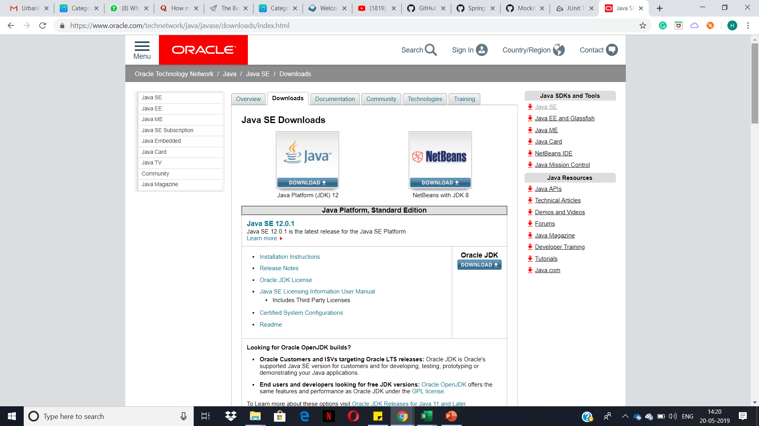
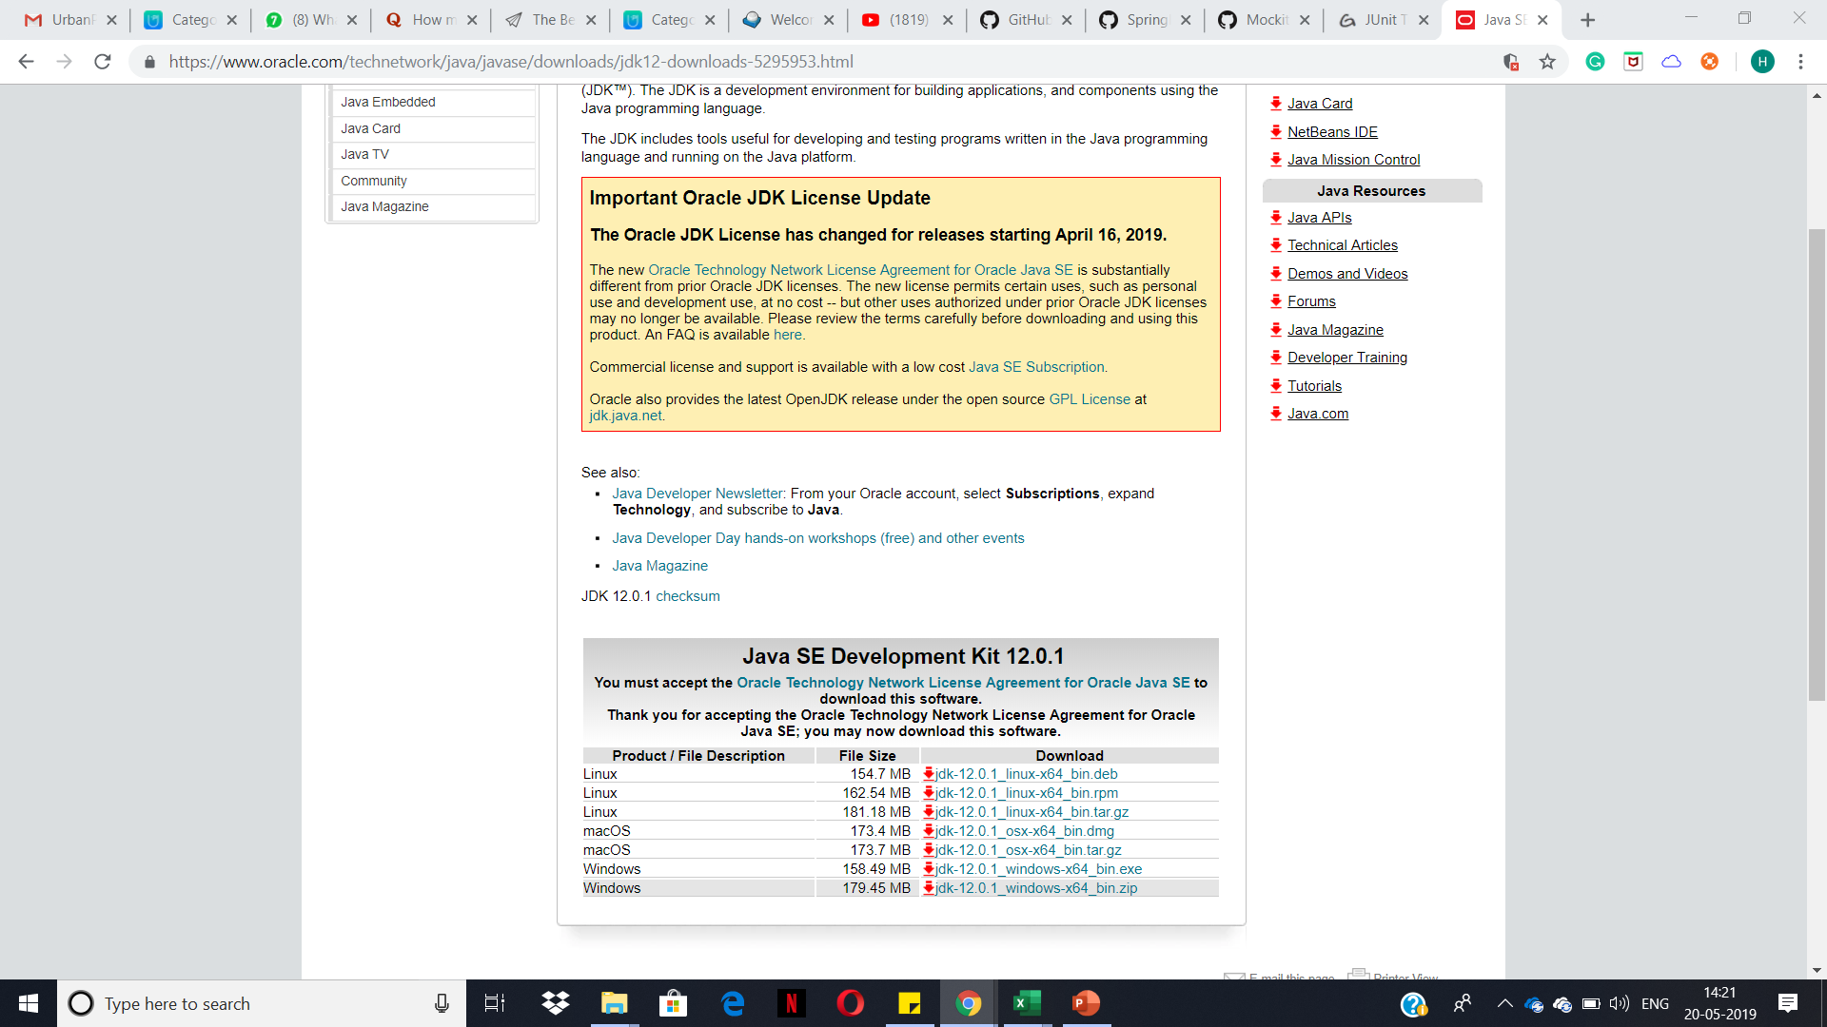
Installing Java JDK
Go to below site to install Java JDK
https://www.oracle.com/technetwork/java/javase/downloads/index.html
2) Select the JDK 12 3) Accept the License Agreement and Click to Download suitable version as per your OS
4) Wait for the Setup to get downloaded. Double click to start the installation.

Slide 9
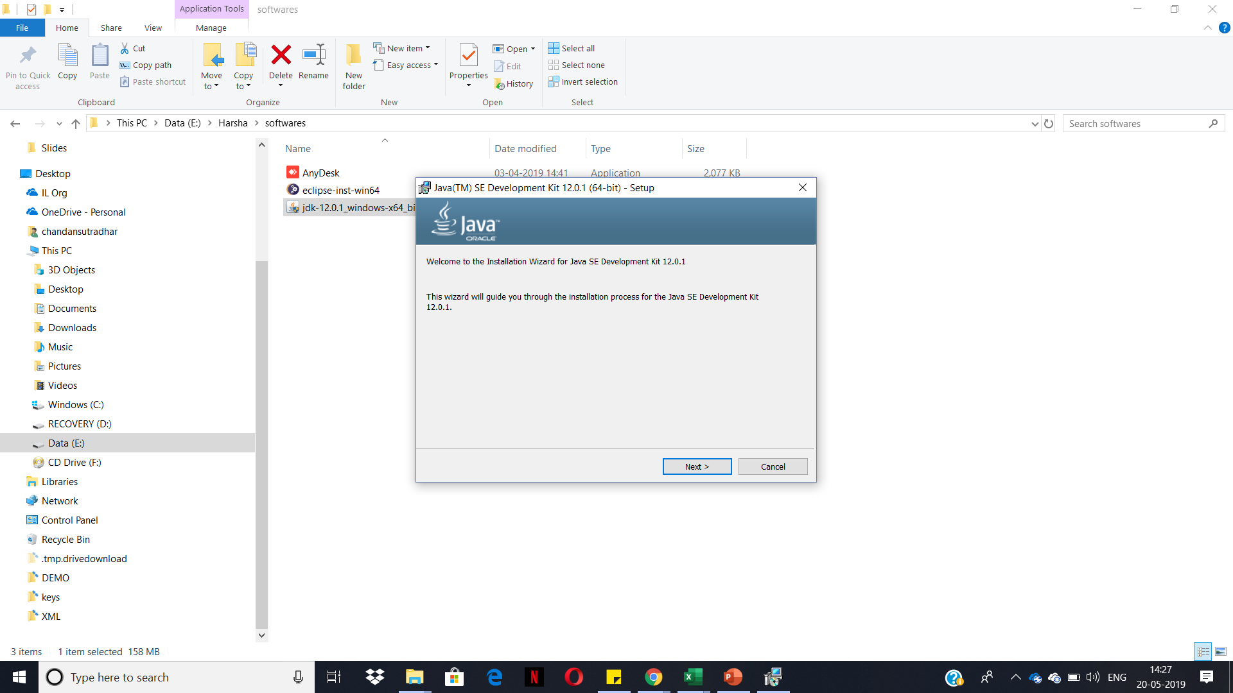
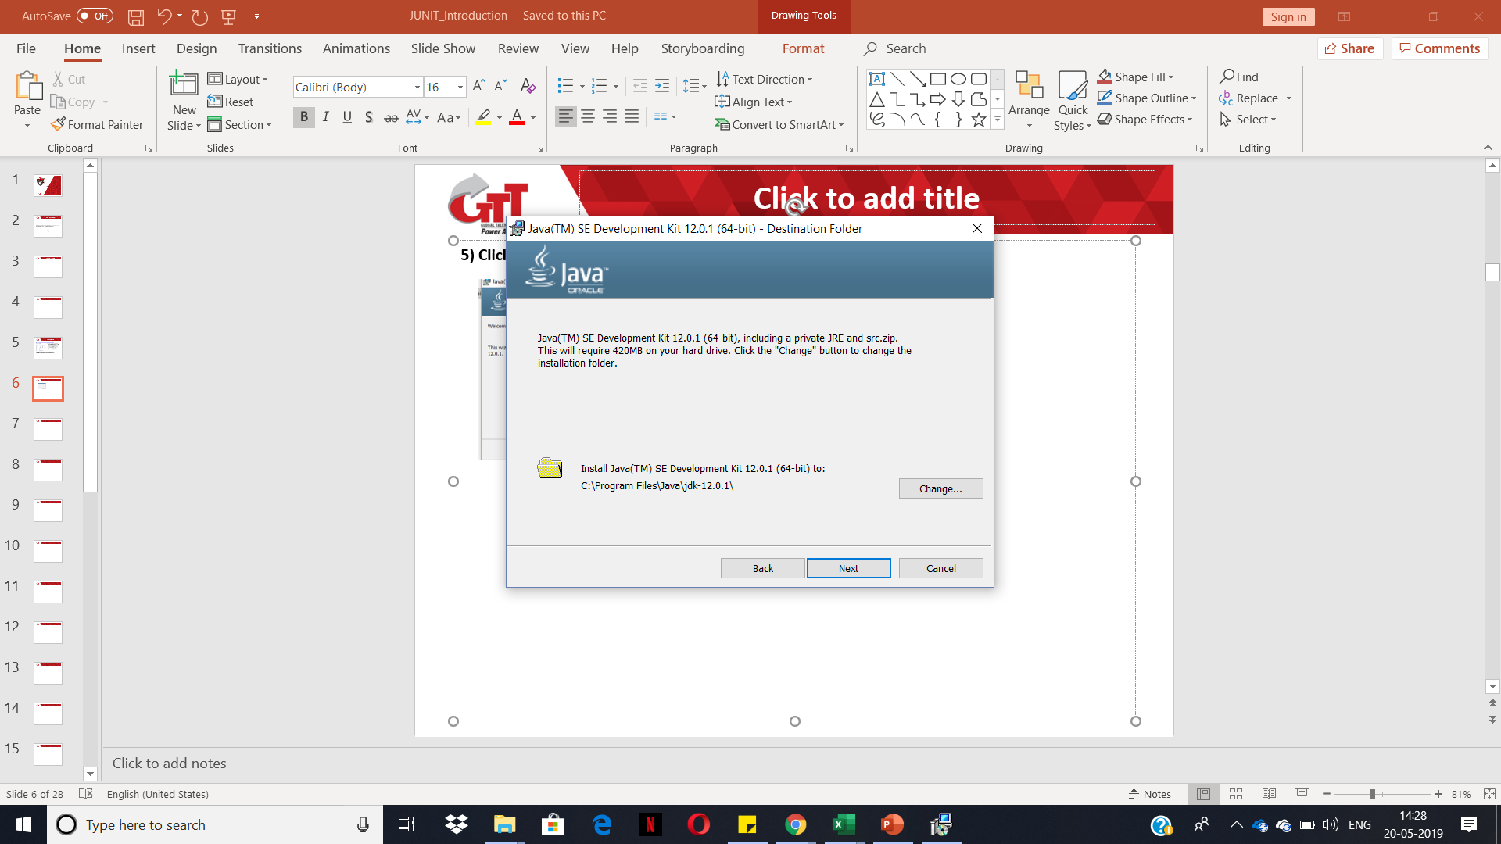
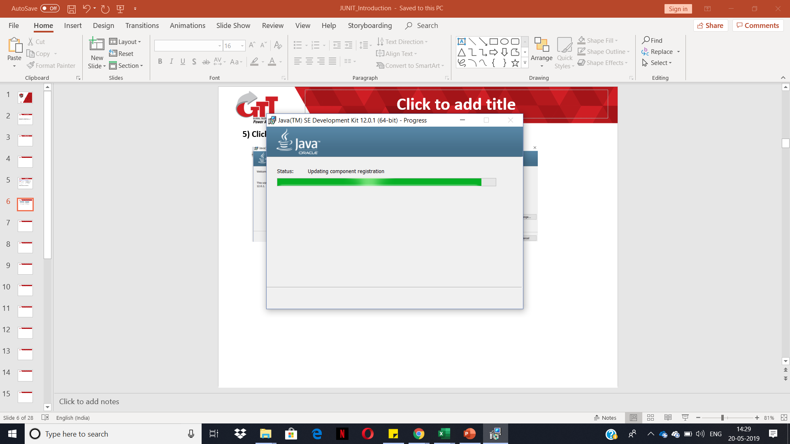
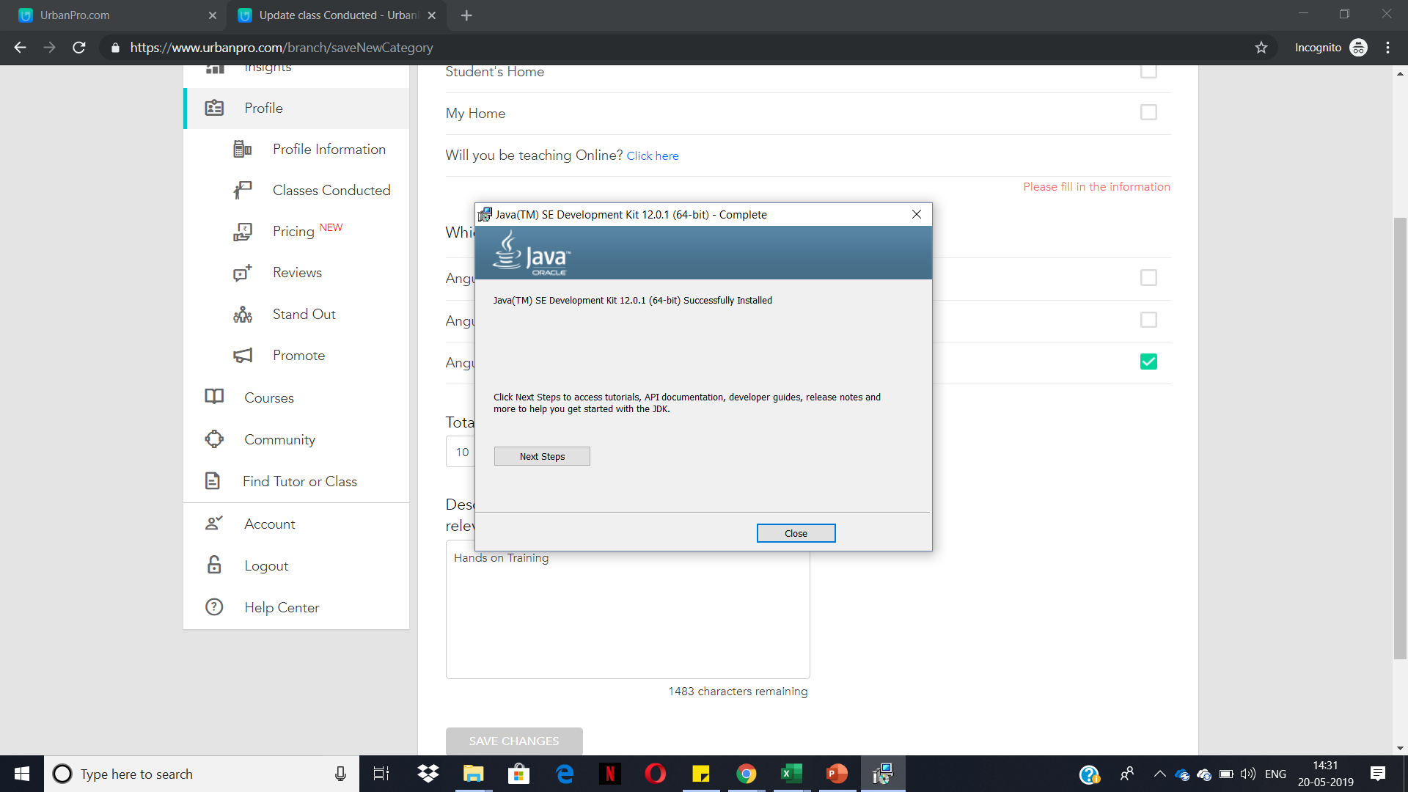
Installing Java JDK Cont..
5) Click Next on the Welcome Screen. 6) Select the install location.
7) Let the status bar finish installing 8) Installation is complete. Click close
components.
Notes:
To check the java jdk installation do the following:
If you are using Windows OS. Go to Command Prompt and type java –version
This should show the current installed version of JAVA
If the response to the java -version command contains 'java' is not recognized, then you must add Java to the system path environment variable:Open the Control Panel.
Click System.
Click Advanced system settings.
On system properties box, click Environment Variables.
In the System Variables box, select Path and click Edit.
Enter the path to your Java installation in the Variable value field. Ensure you enter ';’ at the end.
Click OK on each open dialog box.
Log off from your session, then log back on to activate the change.
To verify, open a command prompt and enter set path to display the current value of the path variable.
Run the command java -version again to verify that Java is installed successfully.

Slide 10
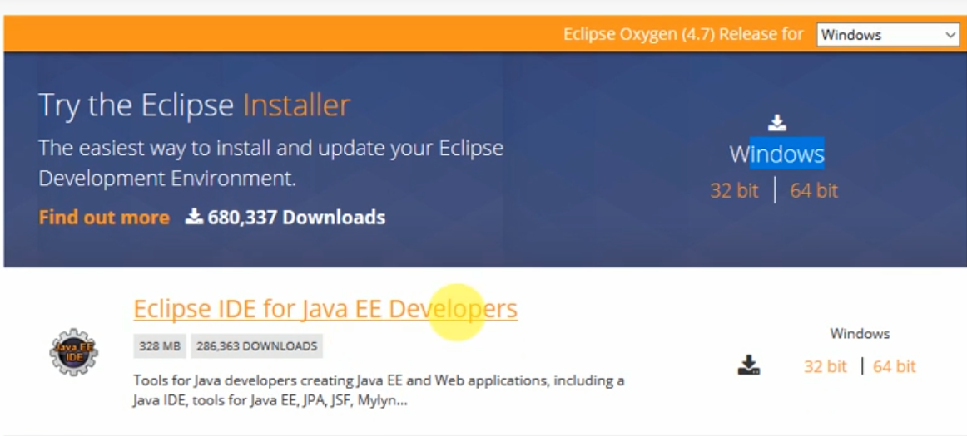

Installation and Setup using an Eclipse IDE
1) Download the latest version of Eclipse installer from https://www.eclipse.org/downloads/

Slide 11
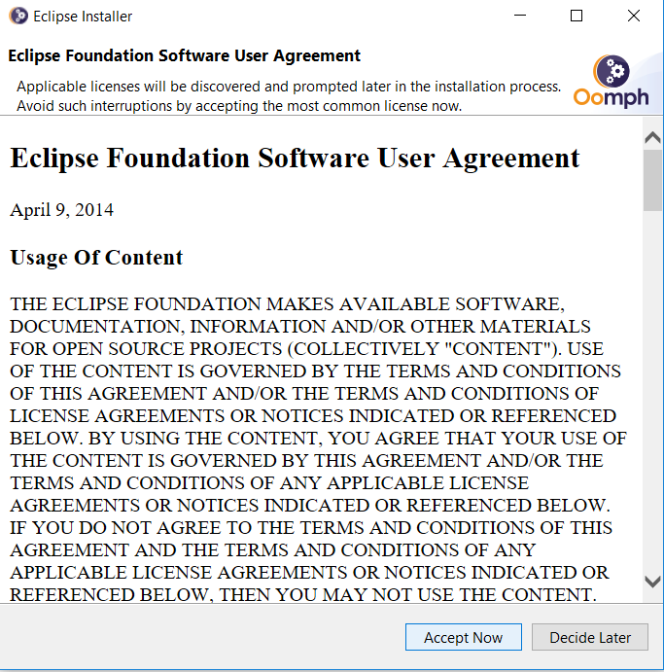
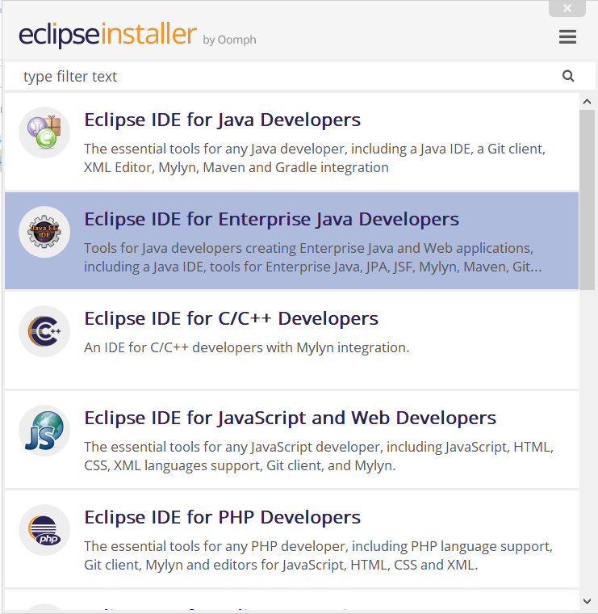
Setting Up Eclipse
2) Run the Installer. Select Eclipse IDE 3) Accept the Agreement to continue.
for Enterprise Java Developers..

Slide 12
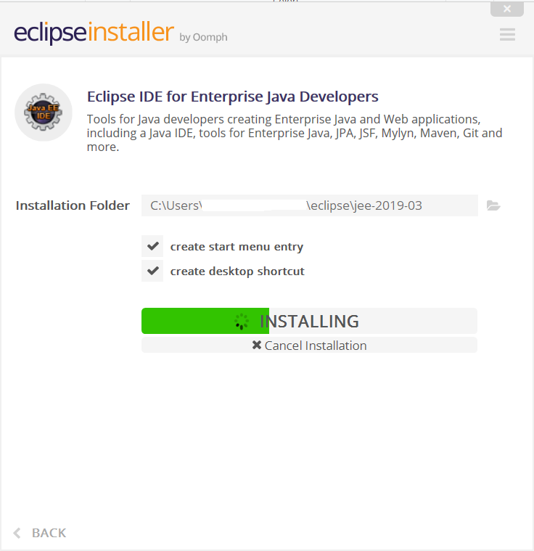

Setting Up Eclipse Cont..
4) Let the installation finish.
5) Launch Eclipse

Slide 13
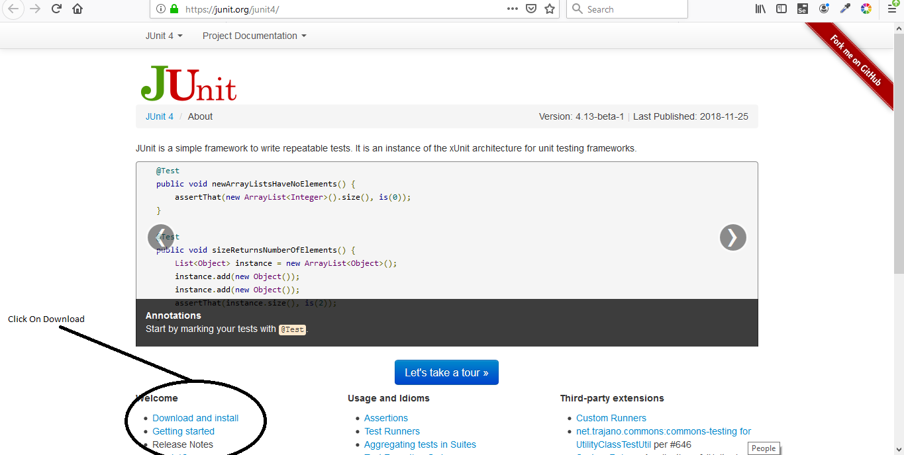
Setting up JUNIT
Step 1:Download Junit from https://junit.org/junit4/

Slide 14
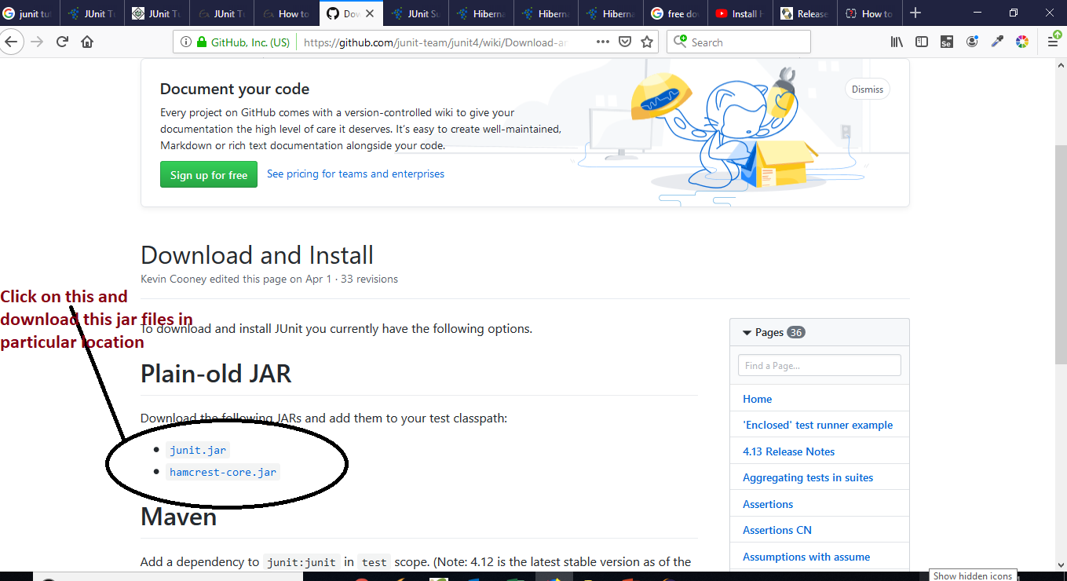
Setting up JUNIT Cont..
Step 2:Click on Download Junit Link and Download jar files of junit

Slide 15
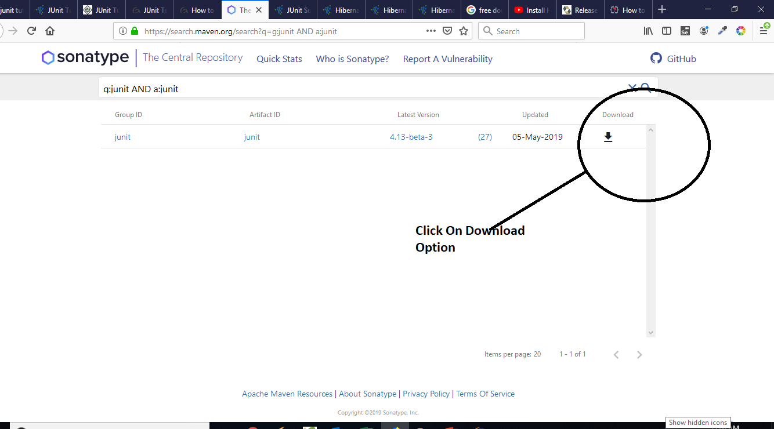
Setting up JUNIT Cont....
Step 3:Click On Download Option

Slide 16
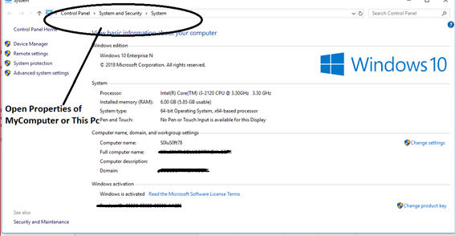
JUnit Environment Setup
Step 1:Once Junit is downloaded, we will Set Path In Our System
Set JUNIT_HOME variable in Advanced Settings.
Base Location of this path is JUNIT jar files which we downloaded.

Slide 17
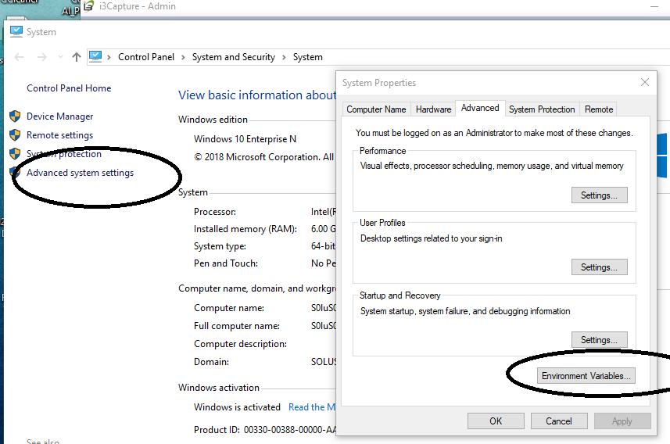
JUnit Environment Setup Cont..
Step 2: Cont.. Environment Variables.

Slide 18
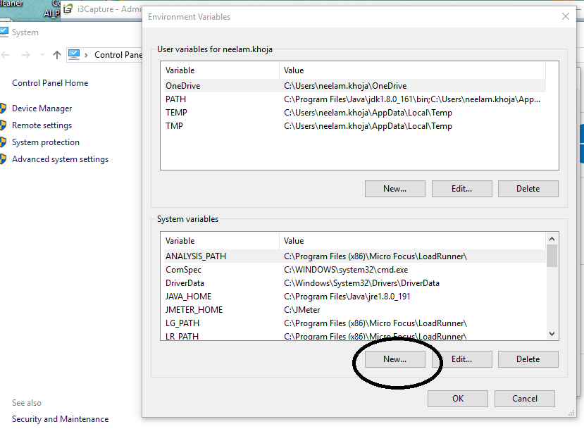
JUnit Environment Setup Cont..
Step 3: Click On Environment Variable→ New Button

Slide 19
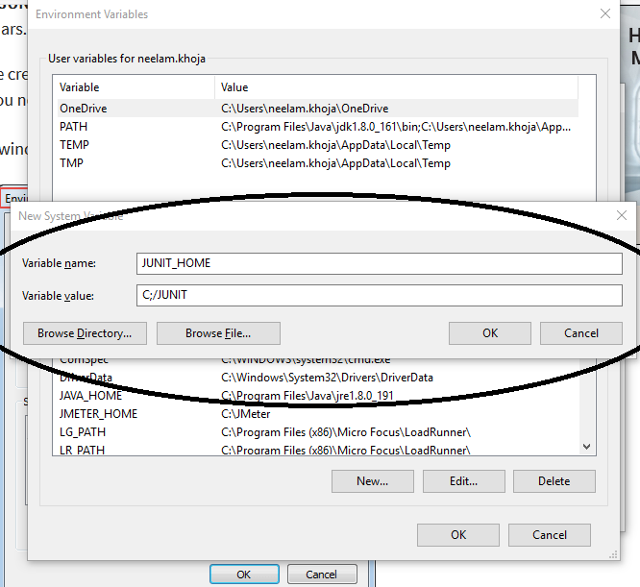
JUnit Environment Setup Cont..
Step 4: Enter Path Of Junit
Notes:
Take JUNIT Folder Location Path

Slide 20
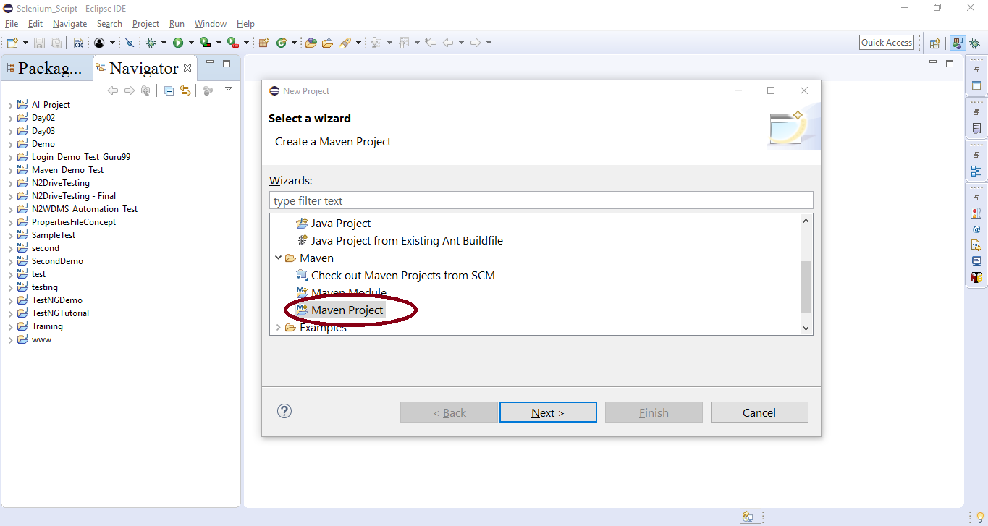
SetUp an Eclipse with Junit and Mockito Framework Duration: 30min
Step 1: Create a New Project in Eclipse and select MAVEN Project

Slide 21
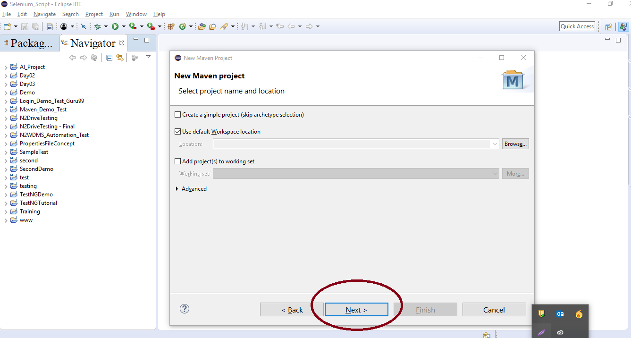
Setup an Eclipse with Junit and Mockito Framework cont..
Step 2: Click On Next Button

Slide 22
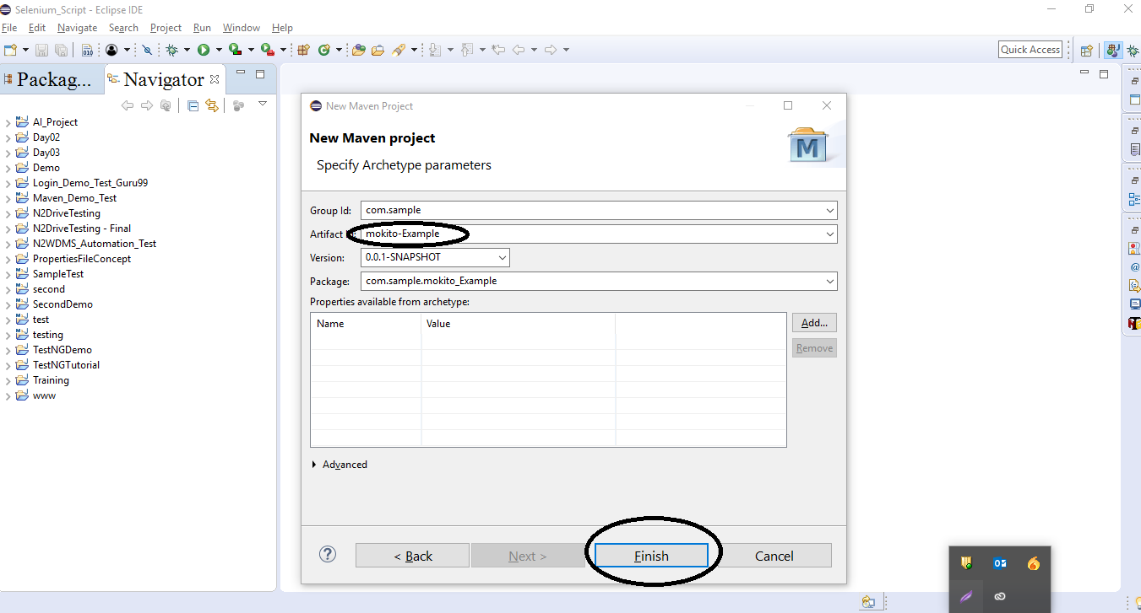
Setup an Eclipse with Junit and Mockito Framework cont..
Step 3: Give name of project and click on Finish Button

Slide 23
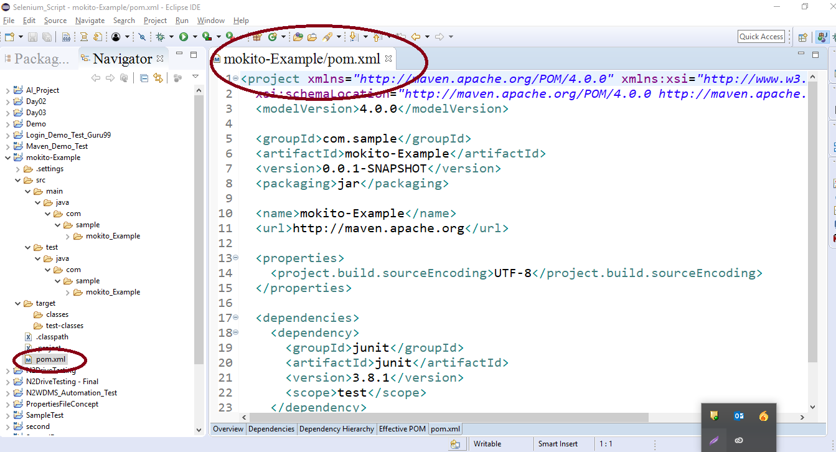
Setup an Eclipse with Junit and Mockito Framework cont..
Step 4: When Create New Project It looks like this.
Step 5: Open POM.XML File and add DEPENDENCIES of MOKITO

Slide 24
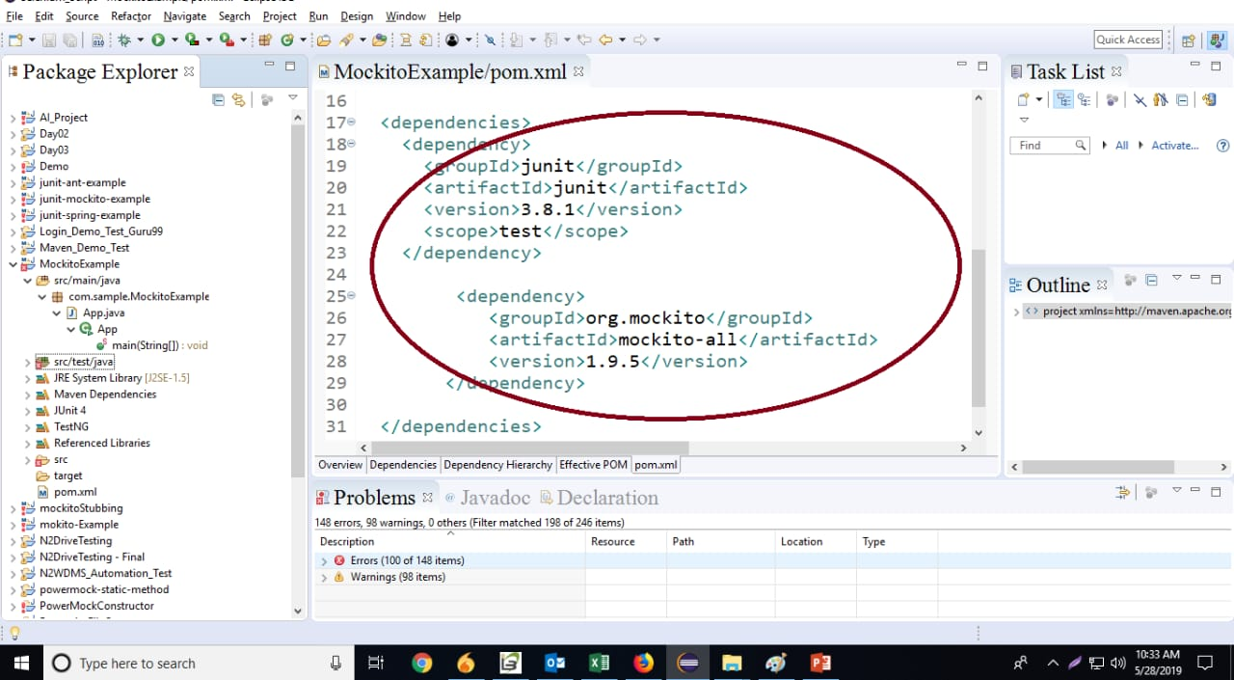
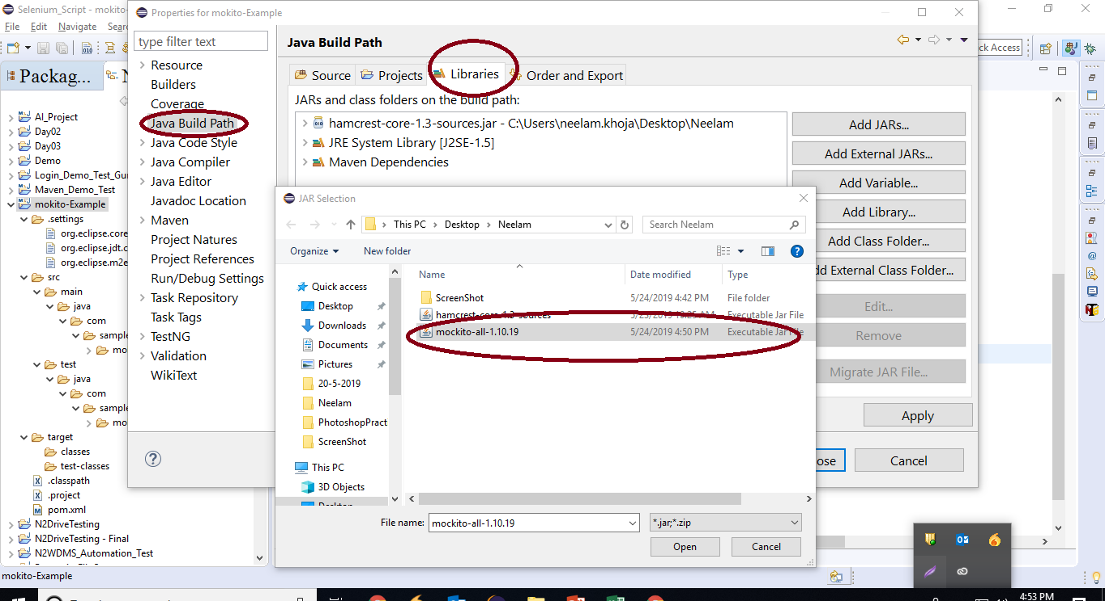
Dependencies of Mockito
Setup an Eclipse with Junit and Mockito Framework cont..
Step 6: Add Mockito jar file from libraries by Right Click of Project and go to build path .

Slide 25
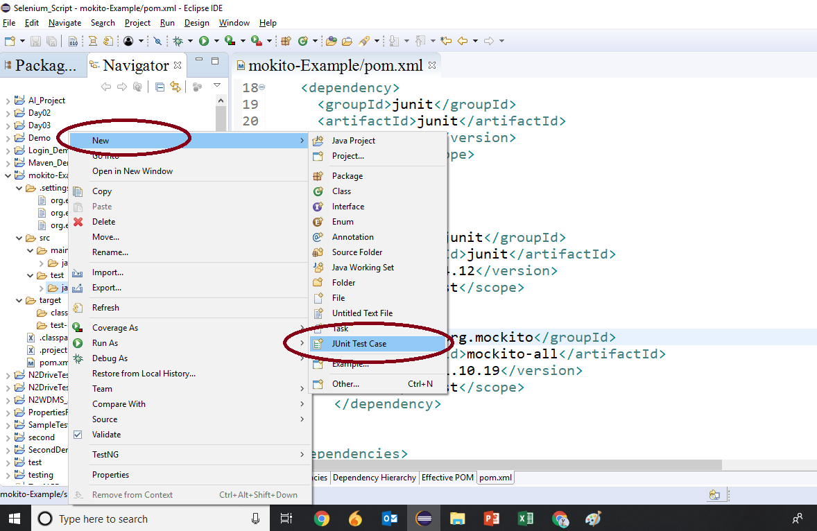
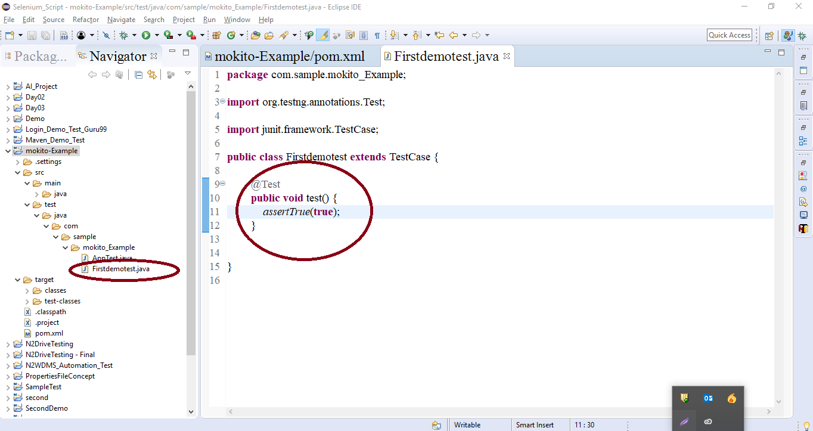
Setup an Eclipse with Junit and Mockito Framework cont..
Step 7:Create New Junit Test Class in Src-Test-Java
Step 8: Write Code in java file

Slide 26
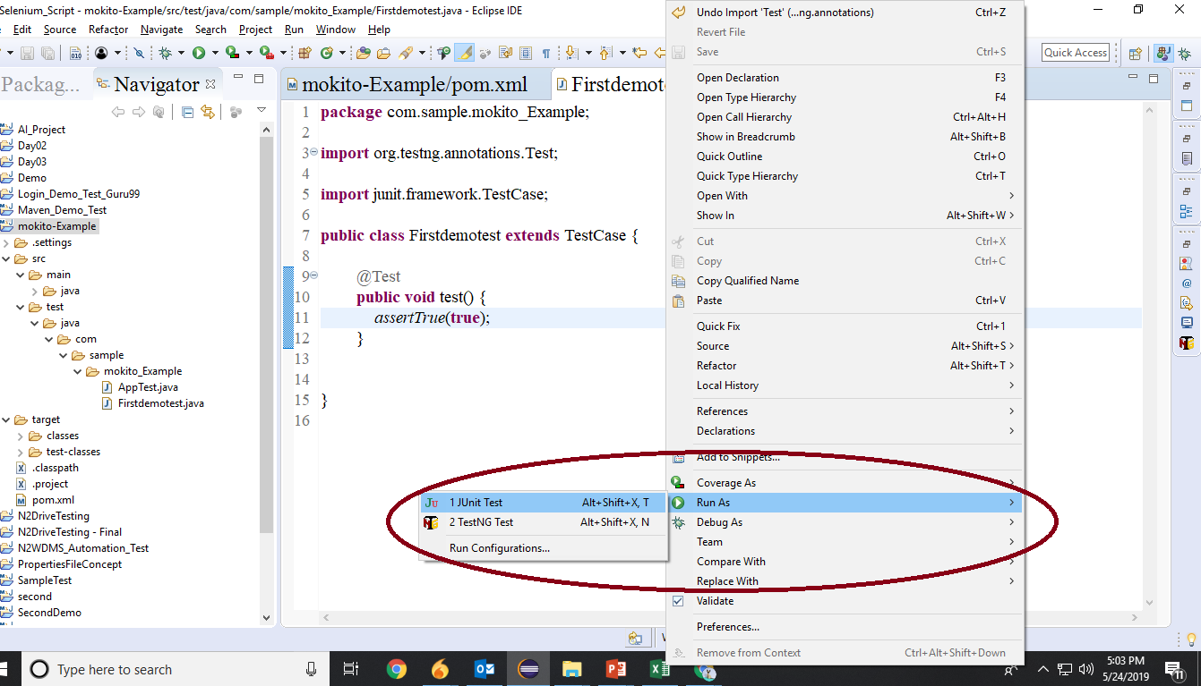
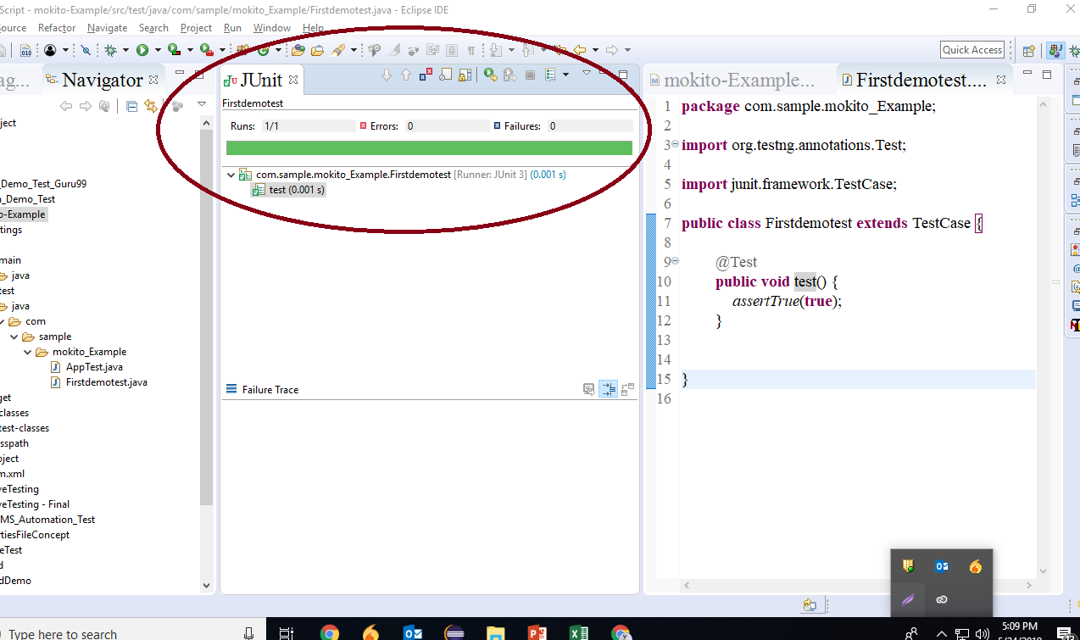
Setup an Eclipse with Junit and Mockito Framework cont..
Step 9: Run as Junit test
Step 10: Result of Testcase is passed

Slide 27
What is Stub?
Stub acts like a real object and is used for unit testing purposes.
Eg: Fake java classes which can be used for testing.
Eg: Simulate a database connection
Using stub, code can be tested without any direct dependency.

Slide 28

Mockito
Mockito is popularly used testing API for Java.
It is used to mock interfaces so that a simulated functionality can be added to a mock interface for unit testing.

Slide 29
Configuration Of Mockito With Eclipse
Maven – the build tool
Eclipse – IDE, version Luna 4.4.1.
TestNG – testing framework
Steps For Program:
Create a new Maven Project
Define the dependencies we need. That is JUnit and Mockito
Code some examples

Slide 30
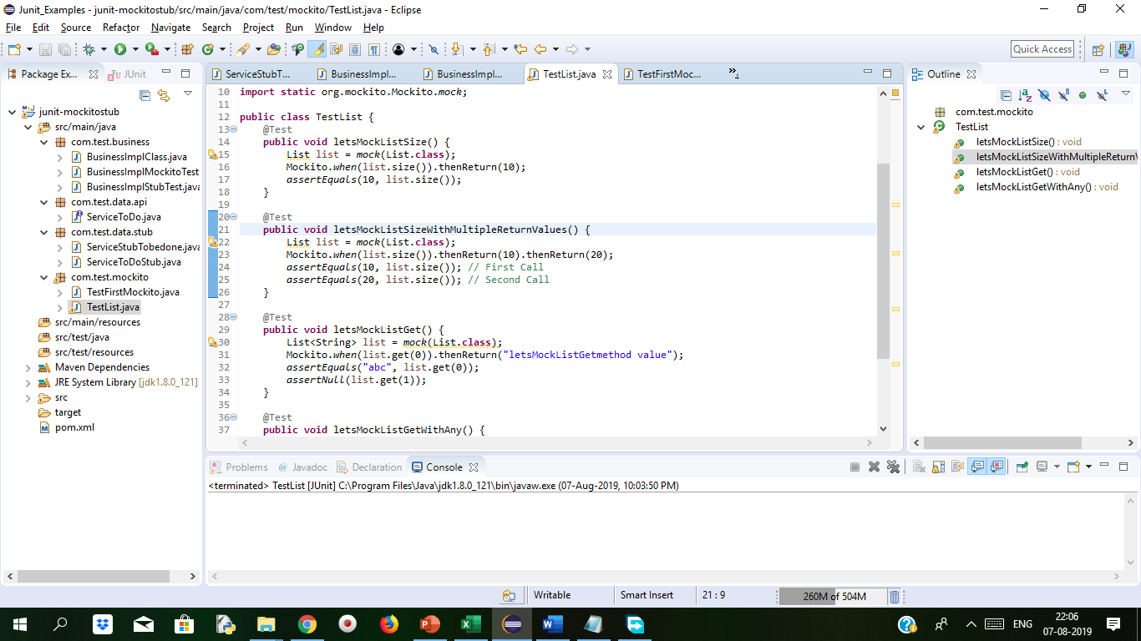
Demo: Configuration Of Mockito With Eclipse Duration:15 min
Step 1 Add Dependency in POM.XML file
Step 2 Add dependencies for Junit and Mockito in pom.xml
<project xmlns="http://maven.apache.org/POM/4.0.0" xmlns:xsi="http://www.w3.org/2001/XMLSchema-instance" xsi:schemaLocation="http://maven.apache.org/POM/4.0.0 http://maven.apache.org/xsd/maven-4.0.0.xsd">
<modelVersion>4.0.0</modelVersion>
<groupId>junit.mockito</groupId>
<artifactId>junit-mockitostub</artifactId>
<version>0.0.1-SNAPSHOT</version>
<dependencies>
<dependency>
<groupId>junit</groupId>
<artifactId>junit</artifactId>
<version>4.12</version>
<scope>test</scope>
</dependency>
<dependency>
<groupId>org.mockito</groupId>
<artifactId>mockito-all</artifactId>
<version>1.10.19</version>
<scope>test</scope>
</dependency>
</dependencies>
</project>

Slide 31
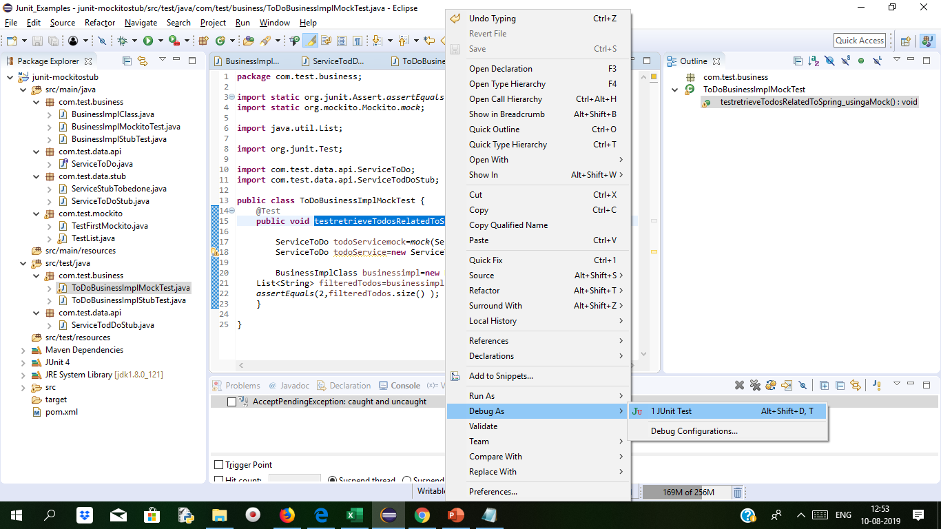
Demo: Configuration Of Mockito With Eclipse Cont..
Step 3 Create Java Class and call the services with BusinessImpl classes.
Step 4 Select the method we want to mock and Debug With Junit
Method to mock

Slide 32
Demo: Stubbing variations with Mockito Duration: 15 min
Step 1 Create Maven Project and Add Mockito libraries The project structure is as below
Add dependencies for Junit and Mockito in pom.xml
<project xmlns="http://maven.apache.org/POM/4.0.0" xmlns:xsi="http://www.w3.org/2001/XMLSchema-instance" xsi:schemaLocation="http://maven.apache.org/POM/4.0.0 http://maven.apache.org/xsd/maven-4.0.0.xsd">
<modelVersion>4.0.0</modelVersion>
<groupId>junit.mockito</groupId>
<artifactId>junit-mockitostub</artifactId>
<version>0.0.1-SNAPSHOT</version>
<dependencies>
<dependency>
<groupId>junit</groupId>
<artifactId>junit</artifactId>
<version>4.12</version>
<scope>test</scope>
</dependency>
<dependency>
<groupId>org.mockito</groupId>
<artifactId>mockito-all</artifactId>
<version>1.10.19</version>
<scope>test</scope>
</dependency>
</dependencies>
</project>

Slide 33
Demo: Stubbing variations with Mockito Cont..
In this example we will observe how we are mocking List interface How multiple argument can be handled when we test the application. How we define stub methods and how throwing of exception is done when we mock. What is Mocking ? It is creating object that simulate the behaviour of real world object. Mock can be dynamically created in code during runtime. Mocks offer more functionality than stubbing.
We will under stand when we run the application as Junit test and verify the method returned with different values.
Create a interface ServiceToDo
package com.test.data.api;
import java.util.List;
public interface ServiceToDo {
public List<String> retrieveTodos(String user);
}
The above interface will declare retrieveTodos method which will be impemented by BusinessImplMockitoTest.java

Slide 34
Demo: Stubbing variations with Mockito Cont..
Below is a ServiceStubTobeDone.java is a class which is implementing ServiceToDo stubs
package com.test.data.stub;
import java.util.Arrays;
import java.util.List;
import com.test.data.api.ServiceToDo;
public class ServiceStubTobedone implements ServiceToDo{
public List<String> retrieveTodos(String user) {
return Arrays.asList("Stub1", "Stub2","Stub3");
}
}

Slide 35
Demo: Stubbing variations with Mockito Cont..
ServiceToDoStub.java
package com.test.data.stub;
import java.util.Arrays;
import java.util.List;
import com.test.data.api.ServiceToDo;
public class ServiceToDoStub implements ServiceToDo {
public List<String> retrieveTodos(String user) {
return Arrays.asList("Stub1", "Stub2","Stub3");
}
}

Slide 36
Demo: Stubbing variations with Mockito Cont..
BusinessImplClass.java which will implements retrieveTodos(user) method for matching arguments passed.
package com.test.business;
import java.util.ArrayList;
import java.util.List;
import com.test.data.api.ServiceToDo;
public class BusinessImplClass {
private ServiceToDo todoService;
BusinessImplClass(ServiceToDo todoService) {
this.todoService = todoService;
}
public List<String> retrieveTodosRelatedToSpring(String user) {
List<String> filteredTodos = new ArrayList<String>();
List<String> allTodos = todoService.retrieveTodos(user);
for (String todo : allTodos) {
if (todo.contains("Abc")) {
filteredTodos.add(todo);
}
}
return filteredTodos;
}}
The above class is known as main SUT i.e. System Under Test whose dependency is todoService.To run BusinessImplClass it has to depend on todoService.

Slide 37
Demo: Stubbing variations with Mockito Cont..
BusinessImplStubTest.java which is test class to return three values.
package com.test.business;
import static org.junit.Assert.assertEquals;
import java.util.List;
import org.junit.Test;
import com.test.data.api.ServiceToDo;
public class BusinessImplStubTest {
@Test
public void usingAStub() {
ServiceToDo todoService = new ServiceToDo() {
public List<String> retrieveTodos(String user) {
// TODO Auto-generated method stub
return null;
}};
BusinessImplClass todoBusinessImpl = new BusinessImplClass(todoService);
List<String> todos = todoBusinessImpl
.retrieveTodosRelatedToSpring("Abc");
assertEquals(2, todos.size());
}
}
Stub is only used for Unit Testing

Slide 38
Demo: Stubbing variations with Mockito Cont..
BusinessImplMockitoTest.java
package com.test.business;
import static org.junit.Assert.assertEquals;
import static org.mockito.Mockito.mock;
import static org.mockito.Mockito.when;
import java.util.Arrays;
import java.util.List;
import org.junit.Test;
import com.test.data.api.ServiceToDo;
public class BusinessImplMockitoTest {
@Test
public void usingMockito() {
ServiceToDo todoService = mock(ServiceToDo.class);
List<String> allTodos = Arrays.asList("Stub1", "Stub2","Stub3");
when(todoService.retrieveTodos("TestMockito")).thenReturn(allTodos);
BusinessImplClass todoBusinessImpl = new BusinessImplClass(todoService);
List<String> todos = todoBusinessImpl
.retrieveTodosRelatedToSpring("Abc");
assertEquals(2, todos.size());
}
}

Slide 39
Demo: Stubbing variations with Mockito Cont..
package com.test.data.api;
import java.util.List;
public interface ServiceToDo {
public List<String> retrieveTodos(String user);
}
package com.test.mockito;
import static org.junit.Assert.assertTrue;
import org.junit.Test;
public class TestFirstMockito {
@Test
public void test() {
assertTrue(true);
}
}

Slide 40
Demo: Stubbing variations with Mockito Cont..
TestList.java
package com.test.mockito;
import static org.junit.Assert.assertEquals;
import static org.junit.Assert.assertNull;
import java.util.List;
import org.junit.Test;
import org.mockito.Mockito;
import static org.mockito.Mockito.mock;
public class TestList {
@Test
public void letsMockListSize() {
List list = mock(List.class);
Mockito.when(list.size()).thenReturn(10);
assertEquals(10, list.size());
}
@Test
public void letsMockListSizeWithMultipleReturnValues() {
List list = mock(List.class);
Mockito.when(list.size()).thenReturn(10).thenReturn(20);
assertEquals(10, list.size()); // First Call
assertEquals(20, list.size()); // Second Call
}
@Test
public void letsMockListGet() {
List<String> list = mock(List.class);
Mockito.when(list.get(0)).thenReturn("letsMockListGetmethod value");
assertEquals("letsMockListGetmethod value", list.get(0));
assertNull(list.get(1));
}
@Test
public void letsMockListGetWithAny() {
List<String> list = mock(List.class);
Mockito.when(list.get(Mockito.anyInt())).thenReturn("letsMockListGetmethod value");
// If you are using argument matchers, all arguments
// have to be provided by matchers.
assertEquals("letsMockListGetmethod value", list.get(0));
assertEquals("letsMockListGetmethod value", list.get(1));
}
}

Slide 41
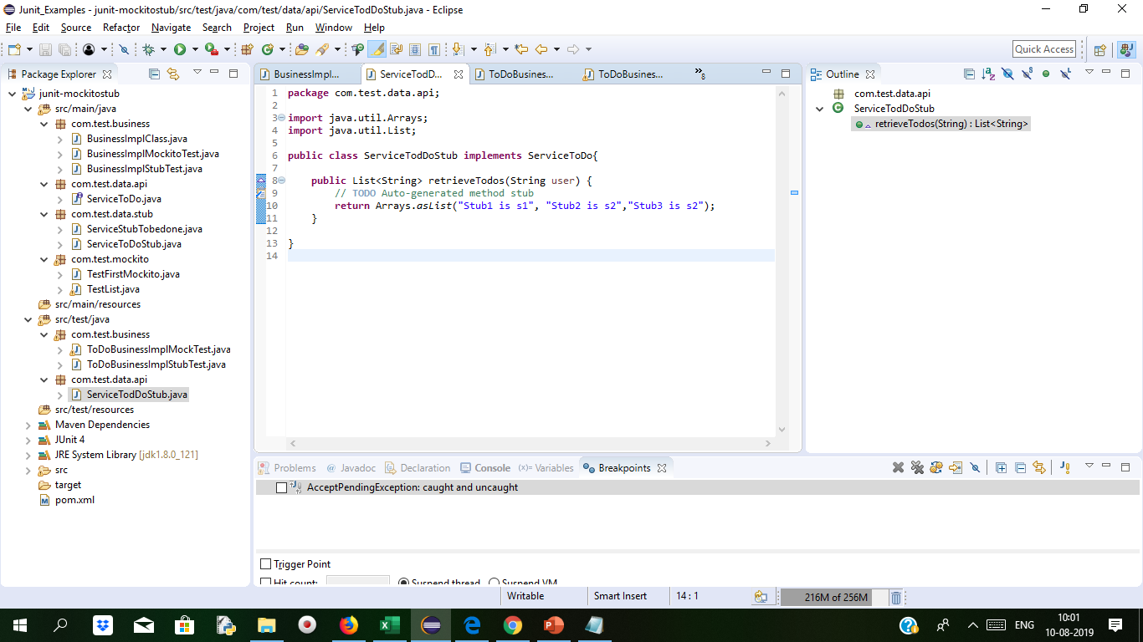
Demo: Stubbing variations with Mockito Cont..
To test the application we will create two new packages com.test.business and com.test.data.api under src/test/java/ and create the new java file ToDoBusinessImplStubTest under com.test.business package and ServiceToDoStub.java in com.test.data.api package.
package com.test.business;
import static org.junit.Assert.*;
import java.util.List;
import org.junit.Test;
import com.test.data.api.ServiceToDo;
import com.test.data.api.ServiceTodDoStub;
public class ToDoBusinessImplStubTest {
@Test
public void testretrieveTodosRelatedToSpring_usingaStub() {
ServiceToDo todoService=new ServiceTodDoStub();
BusinessImplClass businessimpl=new BusinessImplClass(todoService);
List<String> filteredTodos=businessimpl.retrieveTodosRelatedToSpring("is");
assertEquals(2,filteredTodos.size() );
} }
ToDoBusinessImplMockTest

Slide 42
Demo: Stubbing variations with Mockito Cont..
Mock is dynamic and its not hardcoded.
One of the important feature of mock when we call method we don’t have to tell anything to mock.
In the previous example when we mock the method, it will return empty list when we mock rerieveTodos method it will see there is no parameters or the list is explicitely defined so it will return empty list.
So mockito return default values when they are not stubbed
package com.test.business;
import static org.junit.Assert.assertEquals;
import static org.mockito.Mockito.mock;
import java.util.List;
import org.junit.Test;
import com.test.data.api.ServiceToDo;
import com.test.data.api.ServiceTodDoStub;
public class ToDoBusinessImplMockTest {
@Test
public void testretrieveTodosRelatedToSpring_usingaMock() {
ServiceToDo todoServicemock=mock(ServiceToDo.class);
ServiceToDo todoService=new ServiceTodDoStub();
BusinessImplClass businessimpl=new BusinessImplClass(todoServicemock);
List<String> filteredTodos=businessimpl.retrieveTodosRelatedToSpring("Dummy");
assertEquals(2,filteredTodos.size() );
}
}

Slide 43
Demo: Stubbing variations with Mockito Cont..
package com.test.data.api;
import java.util.Arrays;
import java.util.List;
public class ServiceTodDoStub implements ServiceToDo{
public List<String> retrieveTodos(String user)
{
// TODO Auto-generated method stub
return Arrays.asList("Stub1 is s1", "Stub2 is s2","Stub3 is s2");
}}
After Writing the code in src/test/java packages for mocking the method we need to select the method and right click on method and select debug as Junit Test. We can see the variable and and breakpoints tab

Slide 44
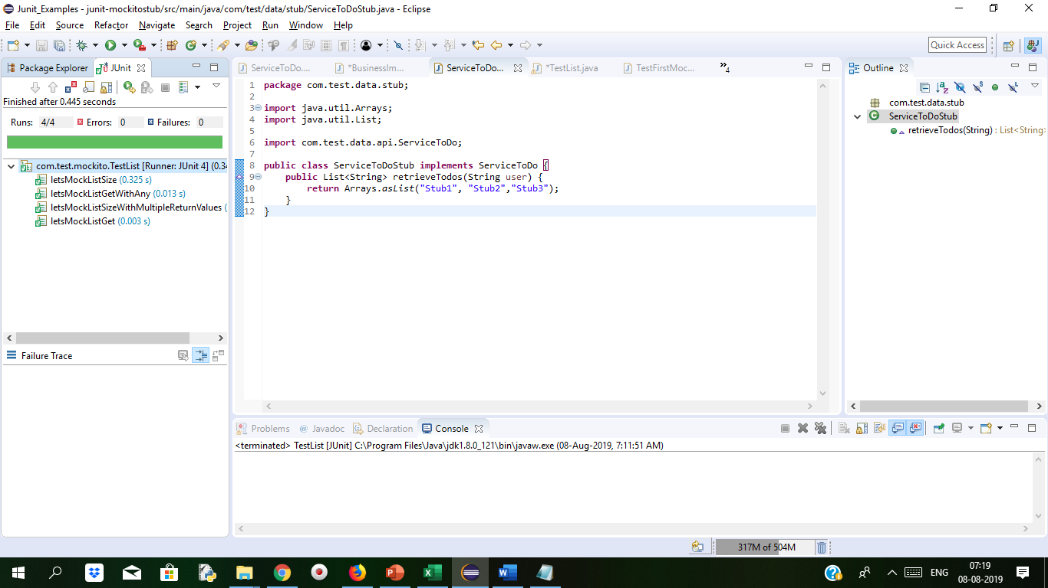
Demo: Stubbing variations with Mockito Cont..
We can see the below screen

Slide 45
EasyMock vs Mockito
EasyMock | Mockito
It has a full fledge guide for installation along with API available for browsing and understanding the framework. | It focuses on simple API rules and has easy ways for developers when mocking classes or interfaces as there is only one kind of mock and one way of creating mocks.
Developers can switch between nice, normal, and strict mocking controls. | Mockito’s extension -PowerMock makes it possible for testing static methods, etc.
Unlike other frameworks, there is no dedicated community to address queries and discussion. | It cannot mock static or private methods. because Mockito prefers object orientation and dependency injection over static, procedural code that is hard to understand & change.

Slide 46
Introduction to BDD
BDD stands for Behaviour-Driven Development and makes it easy for all parties to understand the business requirement.
Its main attention is on the application behavior.
It lays a specific layered approach of writing tests by using below three sections (Arrange, Act, Assert):
given some preconditions (Arrange)
when an action occurs (Act)
then verify the output (Assert)
BDD class is shipped along with Mockito library having BDD-friendly APIs. This API furnishes more developer friendly ways to arrange tests using given() and making assertions using then().

Slide 47
Introduction to BDD Cont..
Maven Dependencies
<dependency> <groupId>org.mockito</groupId> <artifactId>mockito-core</artifactId> <version>2.21.0</version> </dependency>
Imports
import static org.mockito.BDDMockito.*;

Slide 48
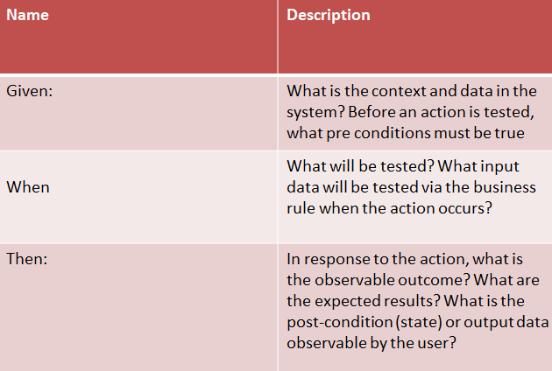
Given When Then
Given-When-Then is a style of representing tests or specifying a system's behavior with all conditions pre and post.
Break up for Given-When-Then

Slide 49
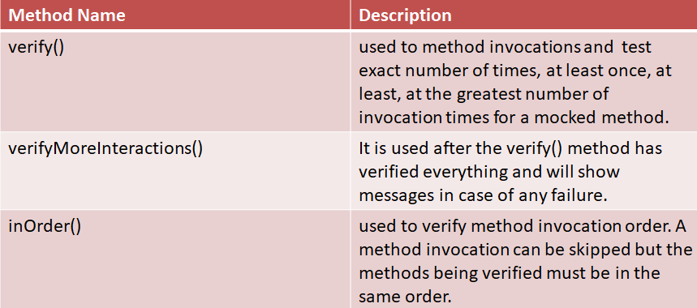
verify calls on a mock
For Ex. @Test void test() { List<String> mockList = mock(List.class); mockList.add("Pankaj"); mockList.size(); verify(mockList).add(“Tom"); }
Notes:
method is
Syntax:

Slide 50
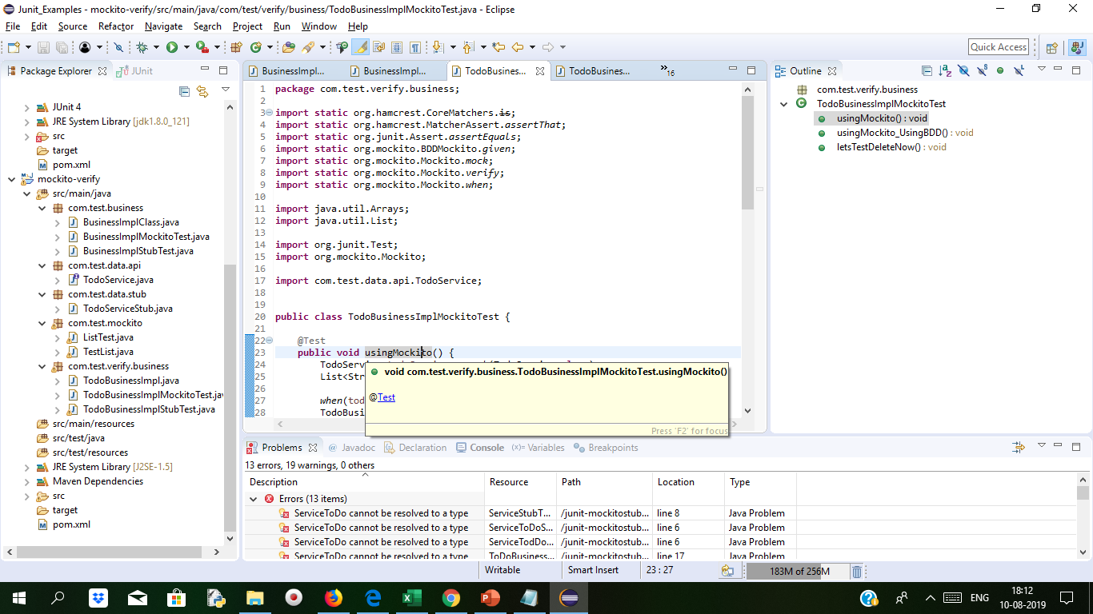
Example to check verify now() Duration:20 min
The Project structure is as below.
We will use the same demo which we made for mock the methods. Only we will add delete method to verify the functionalities.
Below is TodoService.java file
package com.test.data.api;
import java.util.List;
added the deleteTodo() method
public interface TodoService {
public List<String> retrieveTodos(String user);
void deleteTodo(String todo);
}

Slide 51
Example to check verify now() Duration:20 min
package com.test.business;
import static org.junit.Assert.assertEquals;
import java.util.List;
import org.junit.Test;
import com.test.data.api.TodoService;
import com.test.data.stub.TodoServiceStub;
public class BusinessImplStubTest {
@Test
public void usingAStub() {
TodoService todoService = new TodoServiceStub();
BusinessImplClass todoBusinessImpl = new BusinessImplClass(todoService);
List<String> todos = todoBusinessImpl
.retrieveTodosRelatedToSpring(“Admin");
assertEquals(2, todos.size());
}}
package com.test.business;
import java.util.ArrayList;
import java.util.List;
import com.test.data.api.TodoService;
public class BusinessImplClass {
private TodoService todoService;
BusinessImplClass(TodoService todoService) {
this.todoService = todoService;
}
public List<String> retrieveTodosRelatedToSpring(String user) {
List<String> filteredTodos = new ArrayList<String>();
List<String> allTodos = todoService.retrieveTodos(user);
for (String todo : allTodos) {
if (todo.contains("Spring")) {
filteredTodos.add(todo);
}
}
return filteredTodos;
}}

Slide 52
Example to check verify now() Duration:20 min
package com.test.business;
import static org.hamcrest.CoreMatchers.is;
import static org.junit.Assert.assertEquals;
import static org.junit.Assert.assertThat;
import static org.mockito.BDDMockito.given;
import static org.mockito.Mockito.mock;
import static org.mockito.Mockito.verify;
import static org.mockito.Mockito.when;
import java.util.Arrays;
import java.util.List;
import org.junit.Test;
import org.mockito.Mockito;
import com.test.data.api.TodoService;
import com.test.verify.business.TodoBusinessImpl;
public class BusinessImplMockitoTest {
@Test
public void usingMockito() {
TodoService todoService = mock(TodoService.class);
List<String> allTodos = Arrays.asList("Learn Spring MVC",
"Learn Spring", "Learn to Dance");
when(todoService.retrieveTodos(“Admin")).thenReturn(allTodos);
BusinessImplClass todoBusinessImpl = new BusinessImplClass(todoService);
List<String> todos = todoBusinessImpl
.retrieveTodosRelatedToSpring(“Admin");
assertEquals(2, todos.size()); contd..
}

Slide 53
Example to check verify now() Duration:20 min
@Test
public void usingMockito_UsingBDD() {
TodoService todoService = mock(TodoService.class);
BusinessImplClass todoBusinessImpl = new BusinessImplClass(todoService);
List<String> allTodos = Arrays.asList("Learn Spring MVC",
"Learn Spring", "Learn to Dance");
//given
given(todoService.retrieveTodos(“Admin")).willReturn(allTodos);
//when
List<String> todos = todoBusinessImpl
.retrieveTodosRelatedToSpring(“Admin");
//then
assertThat(todos.size(), is(2));
}
@Test
public void letsTestDeleteNow() {
TodoService todoService = mock(TodoService.class);
List<String> allTodos = Arrays.asList("Learn Spring MVC",
"Learn Spring", "Learn to Dance");
when(todoService.retrieveTodos(“Admin")).thenReturn(allTodos);
TodoBusinessImpl todoBusinessImpl = new TodoBusinessImpl(todoService);
todoBusinessImpl.deleteTodosNotRelatedToSpring(“Admin");
verify(todoService).deleteTodo("Learn to Dance");
verify(todoService, Mockito.never()).deleteTodo("Learn Spring MVC");
verify(todoService, Mockito.never()).deleteTodo("Learn Spring");
verify(todoService, Mockito.times(1)).deleteTodo("Learn to Dance");
// atLeastOnce, atLeast
}
}

Slide 54
Example to check verify now() Duration:20 min
deleteTodo() method declaration In TodoServiceStub.java file
package com.test.data.stub;
import java.util.Arrays;
import java.util.List;
import com.test.data.api.TodoService;
public class TodoServiceStub implements TodoService {
public List<String> retrieveTodos(String user) {
return Arrays.asList("Learn Spring MVC", "Learn Spring",
"Learn to Dance");
}
public void deleteTodo(String todo) {
}
}

Slide 55
Example to check verify now() Duration:20 min
List of methods to with @Test annotations
package com.test.mockito;
import static org.hamcrest.CoreMatchers.is;
import static org.hamcrest.MatcherAssert.assertThat;
import static org.junit.Assert.assertEquals;
import static org.junit.Assert.assertNull;
import static org.junit.Assert.assertTrue;
import static org.mockito.BDDMockito.given;
import static org.mockito.Mockito.mock;
import static org.mockito.Mockito.when;
import org.junit.Test;
import org.junit.Test;
import java.util.List;
import org.junit.Test;
import org.mockito.Mockito;
public class ListTest {
@Test
public void letsMockListSize() {
List list = mock(List.class);
when(list.size()).thenReturn(10);
assertEquals(10, list.size());
}
@Test
public void letsMockListSizeWithMultipleReturnValues() {
List list = mock(List.class);
when(list.size()).thenReturn(10).thenReturn(20);
assertEquals(10, list.size()); // First Call
assertEquals(20, list.size()); // Second Call
}
@Test
public void letsMockListGet() {
List<String> list = mock(List.class);
when(list.get(0)).thenReturn("Hello");
assertEquals("Hello", list.get(0));
assertNull(list.get(1));
}
@Test(expected = RuntimeException.class)
public void letsMockListGetToThrowException() {
List<String> list = mock(List.class);
when(list.get(Mockito.anyInt())).thenThrow(
new RuntimeException("Something went wrong"));
list.get(0);
}
@Test
public void letsMockListGetWithAny() {
List<String> list = mock(List.class);
Mockito.when(list.get(Mockito.anyInt())).thenReturn("Hello");
// If you are using argument matchers, all arguments
// have to be provided by matchers.
assertEquals("Hello", list.get(0));
assertEquals("Hello", list.get(1));
}

Slide 56
Example to check verify now() Duration:20 min
@Test
public void bddAliases_UsingGivenWillReturn() {
List<String> list = mock(List.class);
//given
given(list.get(Mockito.anyInt())).willReturn("Hello");
//then
assertThat("Hello", is(list.get(0)));
assertThat("Hello", is(list.get(0)));
}
}
@Test
public void letsMockListSizeWithMultipleReturnValues() {
List list = mock(List.class);
Mockito.when(list.size()).thenReturn(10).thenReturn(20);
assertEquals(10, list.size()); // First Call
assertEquals(20, list.size()); // Second Call
}
@Test
public void letsMockListGet() {
List<String> list = mock(List.class);
Mockito.when(list.get(0)).thenReturn("Hello");
assertEquals("Hello", list.get(0));
assertNull(list.get(1));
}
@Test
public void letsMockListGetWithAny() {
List<String> list = mock(List.class);
Mockito.when(list.get(Mockito.anyInt())).thenReturn("Hello");
// If you are using argument matchers, all arguments
// have to be provided by matchers.
assertEquals("Hello", list.get(0));
assertEquals("Hello", list.get(1));
}
}
Below is a class for testing with Mockito framework
package com.test.mockito;
import static org.junit.Assert.assertEquals;
import static org.junit.Assert.assertNull;
import java.util.List;
import org.junit.Test;
import org.mockito.Mockito;
import static org.mockito.Mockito.mock;
public class TestList {
@Test
public void letsMockListSize() {
List list = mock(List.class);
Mockito.when(list.size()).thenReturn(10);
assertEquals(10, list.size());
}

Slide 57
Example to check verify now() Duration:20 min
Business logic Implementation class
package com.test.verify.business;
import java.util.ArrayList;
import java.util.List;
import com.test.data.api.TodoService;
public class TodoBusinessImpl {
private TodoService todoService;
public TodoBusinessImpl(TodoService todoService) {
this.todoService = todoService;
}
public List<String> retrieveTodosRelatedToSpring(String user) {
List<String> filteredTodos = new ArrayList<String>();
List<String> allTodos = todoService.retrieveTodos(user);
for (String todo : allTodos) {
if (todo.contains("Spring")) {
filteredTodos.add(todo);
}
}
return filteredTodos;
}
public void deleteTodosNotRelatedToSpring(String user) {
List<String> allTodos = todoService.retrieveTodos(user);
for (String todo : allTodos) {
if (!todo.contains("Spring")) {
todoService.deleteTodo(todo);
}}}}
TodoBusinessImplMockitoTest.java for Mockito test
package com.test.verify.business;
import static org.hamcrest.CoreMatchers.is;
import static org.hamcrest.MatcherAssert.assertThat;
import static org.junit.Assert.assertEquals;
import static org.mockito.BDDMockito.given;
import static org.mockito.Mockito.mock;
import static org.mockito.Mockito.verify;
import static org.mockito.Mockito.when;
import java.util.Arrays;
import java.util.List;
import org.junit.Test;
import org.mockito.Mockito;
import com.test.data.api.TodoService;
public class TodoBusinessImplMockitoTest {
@Test
public void usingMockito() {
TodoService todoService = mock(TodoService.class);
List<String> allTodos = Arrays.asList("Learn Spring MVC",
"Learn Spring", "Learn to Dance");
when(todoService.retrieveTodos(“Admin")).thenReturn(allTodos);
TodoBusinessImpl todoBusinessImpl = new TodoBusinessImpl(todoService);
List<String> todos = todoBusinessImpl
.retrieveTodosRelatedToSpring(“Admin");
assertEquals(2, todos.size());
}

Slide 58
Example to check verify now() Duration:20 min
@Test
public void usingMockito_UsingBDD() {
TodoService todoService = mock(TodoService.class);
TodoBusinessImpl todoBusinessImpl = new TodoBusinessImpl(todoService);
List<String> allTodos = Arrays.asList("Learn Spring MVC",
"Learn Spring", "Learn to Dance");
//given
given(todoService.retrieveTodos(“Admin")).willReturn(allTodos);
//when
List<String> todos = todoBusinessImpl
.retrieveTodosRelatedToSpring(“Admin");
//then
assertThat(todos.size(), is(2));
}
@Test
public void letsTestDeleteNow() {
TodoService todoService = mock(TodoService.class);
List<String> allTodos = Arrays.asList("Learn Spring MVC",
"Learn Spring", "Learn to Dance");
when(todoService.retrieveTodos(“Admin")).thenReturn(allTodos);
TodoBusinessImpl todoBusinessImpl = new TodoBusinessImpl(todoService);
todoBusinessImpl.deleteTodosNotRelatedToSpring(“Admin");
verify(todoService).deleteTodo("Learn to Dance");
verify(todoService, Mockito.never()).deleteTodo("Learn Spring MVC");
verify(todoService, Mockito.never()).deleteTodo("Learn Spring");
verify(todoService, Mockito.times(1)).deleteTodo("Learn to Dance");
// atLeastOnce, atLeast}}
For Testing Stub.
TodoBusinessImplStubTest.java
package com.test.verify.business;
import static org.junit.Assert.assertEquals;
import java.util.ArrayList;
import java.util.List;
import org.junit.Test;
import com.test.data.api.TodoService;
import com.test.data.stub.TodoServiceStub;
public class TodoBusinessImplStubTest {
@Test
public void usingAStub() {
TodoService todoService = new TodoServiceStub();
TodoBusinessImpl todoBusinessImpl = new TodoBusinessImpl(todoService);
List<String> todos = todoBusinessImpl
.retrieveTodosRelatedToSpring(“Admin");
assertEquals(2, todos.size());
}
}

Slide 59
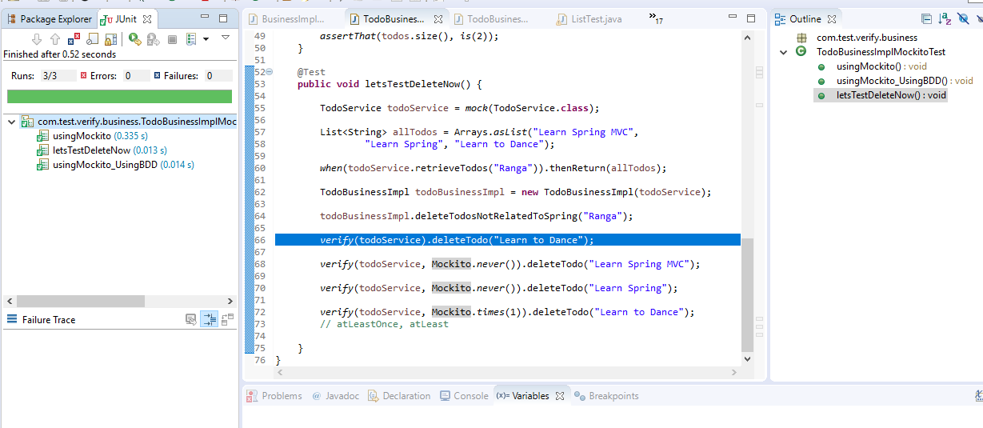
Verify Multiple times a method is called.
After testing the application with different methods for verifying with paramaters we get junit debug as successful.

Slide 60
capture an argument
Create Interface
interface Dao2 { Integer poseQuestion(Wrapper questionWrapper); }
class ManagerImpl2 implements Manager { Dao2 dao; public String poseQuestion(String question) { Wrapper wrapper = new Wrapper(); wrapper.setQuestion(question); wrapper.setDate(new Date()); // wrapper.setMore(...) return dao.poseQuestion(wrapper).toString(); } }

Slide 61
Hamcrest Matchers
For creating matcher objects Hamcrest is the best suitable framework.
It makes the tests very readable by making liberal use of static methods to create easy to write assertion.
Matcher objects are nothing but predicates for dictating rules satisfying under certain conditions.
One of the case where it is used is data validations.
Using it along with JUnit and Mockito makes life easy to write accurate tests satisfying the unit testing principles that is to test one thing at a time.
IN case of matchers failure, detailed output is generated. Along with that it also specifies the expected results compared with the actual result to know the failure reason.
Syntax of a test case below:
@Test public void test_failed() throws Exception { // Given Integer number = 7; // Then assertThat(number, greaterThan(10)); }

Slide 62
Mockito Annotations
@Mock
The @Mock annotation is used to create and inject mocked instances. Real objects are not created but a mock for the class is created.
Example:
@Mock List<String> mockedList; @Test public void whenUseMockAnnotation_thenMockIsInjected() { mockedList.add("one"); Mockito.verify(mockedList).add("one"); assertEquals(0, mockedList.size()); Mockito.when(mockedList.size()).thenReturn(100); assertEquals(100, mockedList.size()); }

Slide 63
Mockito Annotations Cont..
@InjectMocks
@InjectMocks annotation is used to create a class object by including its dependencies which is mocked.
A field is marked on which injection is to be performed. The order in which the mocks are injected are constructor injection, setter injection, or property injection. Failure is not reported in case of failure of any of these strategies.
Example:
@Mock Map<String, String> wordMap; @InjectMocks MyDictionary dic = new MyDictionary(); @Test public void whenUseInjectMocksAnnotation_thenCorrect() { Mockito.when(wordMap.get("aWord")).thenReturn("aMeaning"); assertEquals("aMeaning", dic.getMeaning("aWord")); }

Slide 64
Mockito Annotations Cont..
@RunWith(MockitoJUnitRunner.class):
Use @RunWith(MockitoJUnitRunner.class) at the top of unit test class.
Example:
@RunWith(MockitoJUnitRunner.class) public class ExampleTest { @Mock private List list; @Test public void shouldDoSomething() { list.add(100); } }

Slide 65
Mockito Annotations Cont..
@Captor
The @Captor annotation used to create an ArgumentCaptor instance to capture method argument values.
@Test public void whenNotUseCaptorAnnotation_thenCorrect() { List mockList = Mockito.mock(List.class); ArgumentCaptor<String> arg = ArgumentCaptor.forClass(String.class); mockList.add("one"); Mockito.verify(mockList).add(arg.capture()); assertEquals("one", arg.getValue()); }

Slide 66
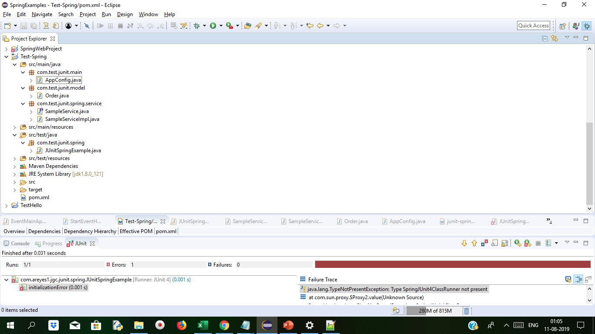
Demo: Real world Example with Spring: Duration:20 min
Create a Maven Project and add the dependency as below
Pom.xml
<project xmlns="http://maven.apache.org/POM/4.0.0" xmlns:xsi="http://www.w3.org/2001/XMLSchema-instance" xsi:schemaLocation="http://maven.apache.org/POM/4.0.0 http://maven.apache.org/xsd/maven-4.0.0.xsd">
<modelVersion>4.0.0</modelVersion>
<groupId>Junit-Spring</groupId>
<artifactId>Test-Spring</artifactId>
<version>0.0.1-SNAPSHOT</version>
<dependencies>
<dependency>
<groupId>junit</groupId>
<artifactId>junit</artifactId>
<version>4.12</version>
<scope>test</scope>
</dependency>
<dependency>
<groupId>org.springframework</groupId>
<artifactId>spring-test</artifactId>
<version>4.0.0.RELEASE</version>
</dependency>
<dependency>
<groupId>org.springframework</groupId>
<artifactId>spring-context</artifactId>
<version>4.0.0.RELEASE</version>
</dependency>
</dependencies>
</project>
The Project Structure

Slide 67
Demo: Real world Example with Spring Cont..
Make Services in and service implementations
package com.test.junit.spring.service;
import com.test.junit.model.Order;
public interface SampleService {
public String getOrderDescription();
public String getOrderStringCode();
public Order getOrder(int id);
public Order createOrder(Order order);
}
public String getOrderStringCode() {
Order existingOrder = new Order();
existingOrder.setSecurityCode(“ABC");
return "Account Code: " + existingOrder.getSecurityCode();
}
public Order createOrder(Order order) {
Order newOrder = new Order();
newOrder.setOrderId(new Random().nextInt());
newOrder.setSecurityCode(“ABC");
newOrder.setOrderStatus("INITIATED");
newOrder.setOrderDate(new Date());
return newOrder;
} public Order getOrder(int id) {
Order newOrder = new Order();
newOrder.setOrderId(new Random().nextInt());
newOrder.setSecurityCode(“ABC");
newOrder.setOrderStatus("COMPLETED");
newOrder.setOrderDate(new Date());
newOrder.setDescription("This is the new ABC order");
return newOrder;
}
}
Service Implementation class
package com.test.junit.spring.service;
import java.util.Date;
import java.util.Random;
import com.test.junit.model.Order;
public class SampleServiceImpl implements SampleService {
public String getOrderDescription() {
Order existingOrder = new Order();
existingOrder.setDescription("Order for ABC in units");
return "Description: " + existingOrder.getDescription();
}

Slide 68
Demo: Real world Example with Spring Cont..
Create ProductOrder.Java and make methods for return value
package com.test.junit.model;
import java.util.Date;
public class Order {
public int orderId;
public String orderStatus;
public String securityCode;
public String description;
public Date orderDate;
public int getOrderId() {
return orderId;
}
public void setOrderId(int orderId) {
this.orderId = orderId;
}
public String getOrderStatus() {
return orderStatus;
}
public void setOrderStatus(String orderStatus) {
this.orderStatus = orderStatus;
}
public String getSecurityCode() {
return securityCode;
}
public void setSecurityCode(String securityCode) {
this.securityCode = securityCode;
}
public Date getOrderDate() {
return orderDate;
}
public void setOrderDate(Date orderDate) {
this.orderDate = orderDate;
}
public String getDescription() {
return description;
}
public void setDescription(String description) {
this.description = description;
}}

Slide 69
Demo: Real world Example with Spring Cont..
package com.test.junit.spring;
import org.junit.After;
import org.junit.AfterClass;
import org.junit.Before;
import org.junit.BeforeClass;
import org.junit.runner.RunWith;
import static org.junit.Assert.*;
import static org.hamcrest.CoreMatchers.*;
import static org.hamcrest.BaseMatcher.*;
import org.springframework.beans.factory.annotation.Autowired;
import com.test.junit.main.AppConfig;
import com.test.junit.model.Order;
import com.test.junit.spring.service.SampleService;
import static org.junit.Assert.assertEquals;
import org.springframework.context.annotation.Bean;
import org.springframework.context.annotation.Configuration;
@RunWith(SpringJUnit4ClassRunner.class)
@ContextConfiguration(classes=AppConfig.class,loader=AnnotationConfigContextLoader.class)
public class JUnitSpringExample {
@Autowired
private SampleService sampleService;
@BeforeClass
public static void setUp() {
System.out.println("-----> SETUP <-----");
}
@Test
public void testSampleService() {
assertEquals("class com.test.junit.spring.service.SampleServiceImpl",this.sampleService.getClass().toString());
}
@Test
public void testSampleServiceGetAccountDescription() {
//Check if the return description has a 'Description:' string.
assertTrue(sampleService.getOrderDescription().contains("Description:"));
}
@Test
public void testSampleServiceGetAccountCode() {
//Check if the return description has a 'Code:' string.
assertTrue(sampleService.getOrderStringCode().contains("Code:"));
}
@Test
public void testSampleServiceCreateNewOrder() {
Order newOrder = new Order();
newOrder.setSecurityCode(“ABC");
newOrder.setDescription("Description");
if(newOrder != null) {
assertThat(sampleService.createOrder(newOrder), instanceOf(Order.class));
assertNotNull("Security isn't null", newOrder.getSecurityCode());
assertNotNull("Description isn't not null", newOrder.getDescription());
}
assertNotNull("New Order is not null", newOrder);
}
contd…

Slide 70
Demo: Real world Example with Spring Cont..
@Test
public void testSampleServiceGetOrder() {
Order existingOrder = sampleService.getOrder(0);
if(existingOrder != null) {
assertThat(sampleService.getOrder(0), instanceOf(Order.class));
assertNotNull("Security isn't null", existingOrder.getSecurityCode());
assertNotNull("Description isn't null", existingOrder.getDescription());
}
assertNotNull("Object is not null", existingOrder);
}
@AfterClass
public static void afterTest() {
System.out.println("-----> DESTROY <-----");
}
}
AppConfig.java file which has application configuration
package com.test.junit.main;
import org.springframework.context.annotation.Bean;
import org.springframework.context.annotation.Configuration;
import com.test.junit.spring.service.SampleService;
import com.test.junit.spring.service.SampleServiceImpl;
@Configuration
public class AppConfig {
@Bean
public SampleService getSampleService() {
return new SampleServiceImpl();
}
}

Slide 71
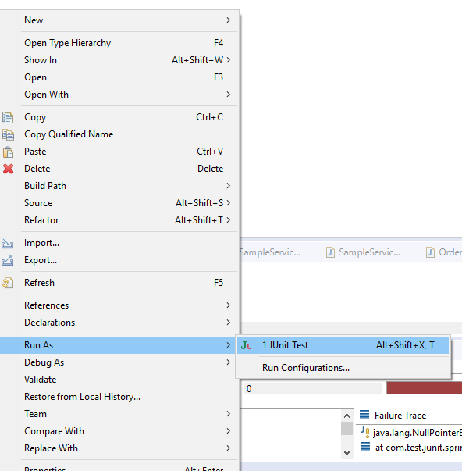
Demo: Real world Example with Spring Cont..
Run with JUnit

Slide 72
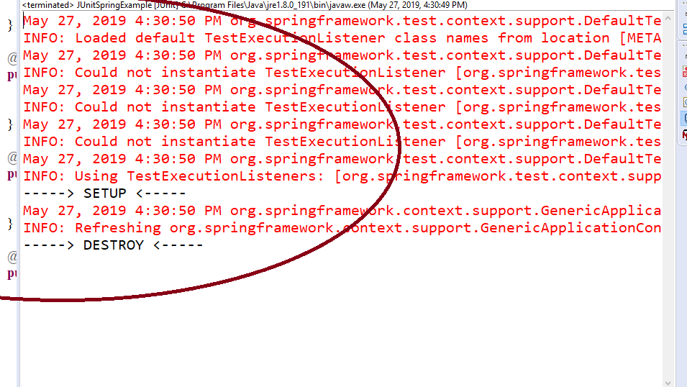
Demo: Real world Example with Spring Cont..
Output

Slide 73
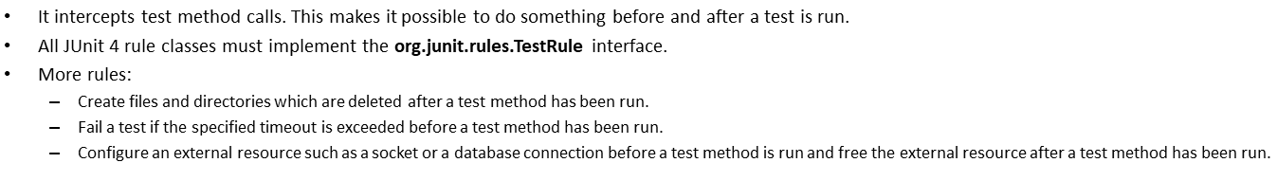
Junit Rules
import org.junit.Rule; import org.junit.Test; import org.junit.rules.TemporaryFolder; import java.io.File; import java.io.IOException; import static org.junit.Assert.assertEquals; import static org.junit.Assert.assertTrue; public class RuleTest { @Rule public TemporaryFolder tmpFolder = new TemporaryFolder(); | @Test public void shouldCreateNewFileInTemporaryFolder() throws IOException { File created = tmpFolder.newFile("file.txt"); assertTrue(created.isFile()); assertEquals(tmpFolder.getRoot(), created.getParentFile()); } }

Slide 74
What is a spy?
Spy helps to partially mock an object. During this process, it calls the real methods unless it’s stubbed.
Real objects are created and spied by using @Spy annotation.
@Spy HashMap<String, Integer> hashMap; @Test public void saveTest() { hashMap.put("A", 10); Mockito.verify(hashMap, times(1)).put("A", 10); Mockito.verify(hashMap, times(0)).get("A"); assertEquals(1, hashMap.size()); assertEquals(new Integer(10), (Integer) hashMap.get("A")); }

Slide 75
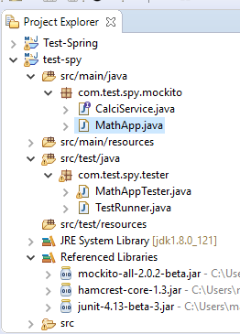
Demo: How to spy with Mockito? Duration:10 min
Step 1: Create Java Project. The project structure is as below.Then add below classes
package com.test.spy.mockito;
public class MathApp {
private CalciService calcService;
public void setCalculatorService(CalciService calcService){
this.calcService = calcService;
}
public double add(double input1, double input2){
return calcService.add(input1, input2);
}
public double subtract(double input1, double input2){
return calcService.subtract(input1, input2);
}
public double multiply(double input1, double input2){
return calcService.multiply(input1, input2);
}
public double divide(double input1, double input2){
return calcService.divide(input1, input2);
}}
package com.test.spy.mockito;
public interface CalciService {
public double add(double input1, double input2);
public double subtract(double input1, double input2);
public double multiply(double input1, double input2);
public double divide(double input1, double input2);
}

Slide 76
Demo: How to spy with Mockito? Cont..
package com.test.spy.tester;
import static org.mockito.Mockito.spy;
import org.junit.Before;
import org.junit.Test;
import org.junit.runner.RunWith;
import org.mockito.runners.MockitoJUnitRunner;
import com.test.spy.mockito.CalciService;
import com.test.spy.mockito.MathApp;
import junit.framework.Assert;
@RunWith(MockitoJUnitRunner.class)
public class MathAppTester {
private MathApp mathApplication;
private CalciService calcService;
@Before
public void setUp(){
mathApplication = new MathApp();
Calculator calculator = new Calculator();
calcService = spy(calculator);
mathApplication.setCalculatorService(calcService);
}
@Test
public void testAdd(){
//perform operation on real object
//test the add functionality
Assert.assertEquals(mathApplication.add(20.0, 10.0),30.0,0);
}
class Calculator implements CalciService {
public double add(double input1, double input2) {
return input1 + input2;
}
public double subtract(double input1, double input2) {
throw new UnsupportedOperationException("Method not implemented yet!");
}
public double multiply(double input1, double input2) {
throw new UnsupportedOperationException("Method not implemented yet!");
}
public double divide(double input1, double input2) {
throw new UnsupportedOperationException("Method not implemented yet!");
}
}
}

Slide 77
Demo: How to spy with Mockito? Cont..
TestRunner.java file to run the application
package com.test.spy.tester;
import org.junit.runner.JUnitCore;
import org.junit.runner.Result;
import org.junit.runner.notification.Failure;
public class TestRunner {
public static void main(String[] args) {
Result result = JUnitCore.runClasses(MathAppTester.class);
for (Failure failure : result.getFailures()) {
System.out.println(failure.toString());
}
System.out.println(result.wasSuccessful());
}
}
To Test MathApp class by injecting in it a mock of calciService.
Mock will be created by Mockito when we inject.
Also we've added one mock method calls, add() to the mock object via when() clause. However during testing process, we've called subtract() method before calling add() method. When we create a mock object using Mockito.createStrictMock(), the order of execution of the method calls matters.

Slide 78
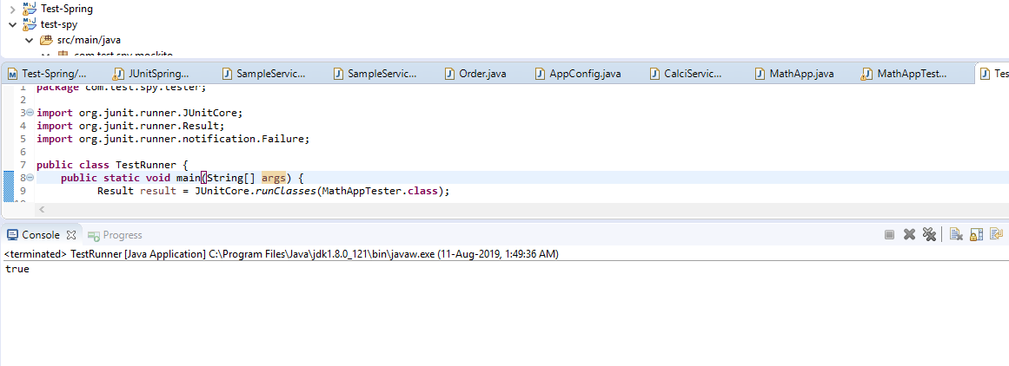
Demo: How to spy with Mockito? Cont..
Output

Slide 79
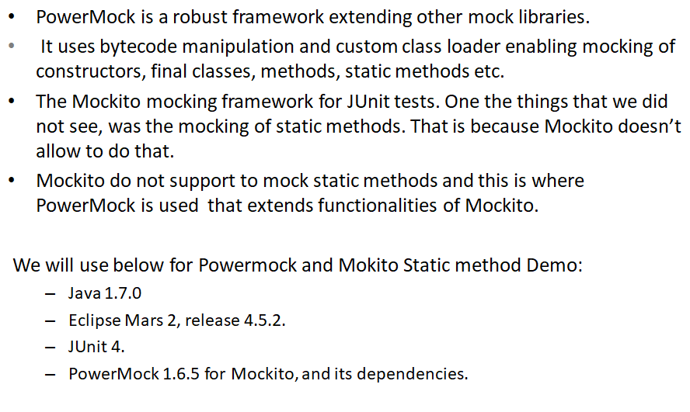
PowerMock and Mockito to mock a Static Method

Slide 80
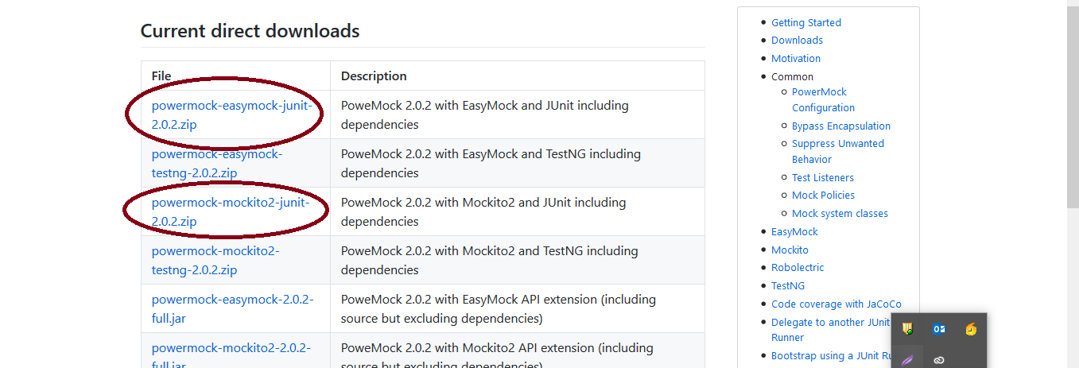
Demo: Duration:10 min
Step 1:Powermock installation
Go to below link
https://www.powermockup.com/download

Slide 81
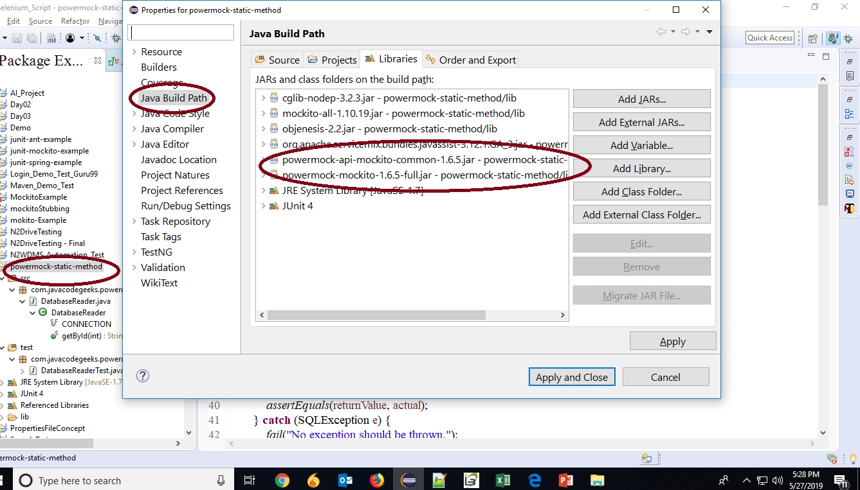
Demo: Cont..
Step 2:Project creation

Slide 82
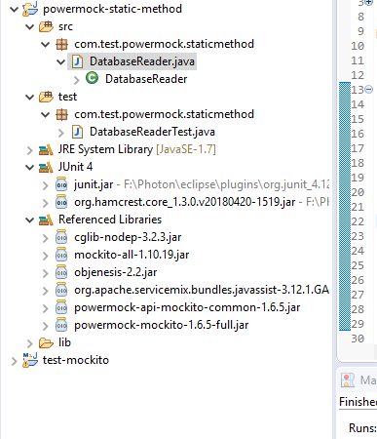
Demo: Cont..
To develop a class for making a query against a database
package com.test.powermock.staticmethod;
import java.sql.Connection;import java.sql.DriverManager;import java.sql.PreparedStatement;import java.sql.ResultSet;import java.sql.SQLException;
public class DatabaseReader {
public static final String CONNECTION = "jdbc:mysql://localhost/userdb";
public static String getById(int id) throws SQLException { String query = "SELECT * FROM users WHERE userid = ?"; Connection connection = DriverManager.getConnection(CONNECTION); PreparedStatement preparedStatement = connection.prepareStatement(query);
preparedStatement.setInt(1, id);
ResultSet resultSet = preparedStatement.executeQuery();
resultSet.next();
String result = resultSet.getString(0); resultSet.close(); preparedStatement.close(); connection.close(); return result; }}

Slide 83
Demo: Cont..
mocking getById static method with the help of PowerMock:
package com.test.powermock.staticmethod;import static org.junit.Assert.assertEquals;import static org.junit.Assert.fail;import static org.mockito.Mockito.when;import static org.mockito.Mockito.verify;import static org.powermock.api.mockito.PowerMockito.mockStatic;import static org.powermock.api.mockito.PowerMockito.verifyStatic;import java.sql.Connection;import java.sql.DriverManager;import java.sql.PreparedStatement;import java.sql.ResultSet;import java.sql.SQLException;import org.junit.Test;import org.junit.runner.RunWith;import org.mockito.Mockito;import org.powermock.core.classloader.annotations.PrepareForTest;import org.powermock.modules.junit4.PowerMockRunner;
import com.test.powermock.staticmethod.DatabaseReader;
@RunWith(PowerMockRunner.class)@PrepareForTest(DatabaseReader.class)
public class DatabaseReaderTest
{ @Test public void testGetById() { int inputId = 1;
String returnValue = "test"; mockStatic(DatabaseReader.class); try { when(DatabaseReader.getById(inputId)) .thenReturn(returnValue); String actual = DatabaseReader.getById(inputId); verifyStatic(); assertEquals(returnValue, actual); } catch (SQLException e) { fail("No exception should be thrown."); } }
}
@Test
public void testGetByIdMockDatabase() {
String query = "SELECT * FROM users WHERE userid = ?";
int inputId = 1;
String returnValue = "test";
Connection connectionMock = Mockito.mock(Connection.class);
PreparedStatement preparedStatementMock = Mockito.mock(PreparedStatement.class);
ResultSet resultSetMock = Mockito.mock(ResultSet.class);
mockStatic(DriverManager.class);
try {
when(DriverManager.getConnection(DatabaseReader.CONNECTION))
.thenReturn(connectionMock);
when(connectionMock.prepareStatement(query))
.thenReturn(preparedStatementMock);
when(preparedStatementMock.executeQuery())
.thenReturn(resultSetMock);
when(resultSetMock.next())
.thenReturn(true);
when(resultSetMock.getString(0))
.thenReturn(returnValue);
contd..

Slide 84
Demo: Cont..
String actual = DatabaseReader.getById(inputId);
verify(connectionMock).prepareStatement(query);
verify(preparedStatementMock).executeQuery();
verify(resultSetMock).next();
verify(resultSetMock).getString(0);
verifyStatic();
assertEquals(returnValue, actual);
} catch (SQLException e) {
fail("No exception should be thrown.");
}}}

Slide 85
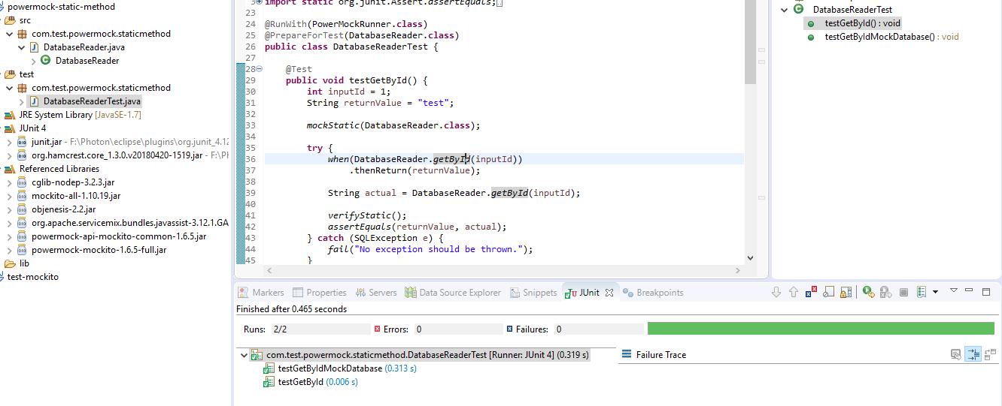
Demo: Cont..
Output

Slide 86
PowerMock and Mockito to invoke a private Method
Spy object is used when there is private method used in class which needs to be mocked.
Mockito does not support mocking private methods, we can use other tools which supports this.
Example:
import org.junit.Assert; import org.junit.Test; import org.junit.runner.RunWith; import org.mockito.Mockito; import org.powermock.api.mockito.PowerMockito; import org.powermock.core.classloader.annotations.PrepareForTest; import org.powermock.modules.junit4.PowerMockRunner; @RunWith(PowerMockRunner.class) @PrepareForTest(MockPrivateMethodExample.class) public class MockPrivateMethodTest { private MockPrivateMethodExample mockPrivateMethodExample; | // This is the name of the private method which we want to mock private static final String METHOD = "iAmPrivate"; @Test public void testPrivateMethod() throws Exception { mockPrivateMethodExample = new MockPrivateMethodExample(); MockPrivateMethodExample spy = PowerMockito.spy(mockPrivateMethodExample); PowerMockito.doReturn("Test").when(spy, METHOD); String value = spy.getDetails(); Assert.assertEquals(value, "Mock private method example: Test"); PowerMockito.verifyPrivate(spy, Mockito.times(1)).invoke(METHOD); } }

Slide 87
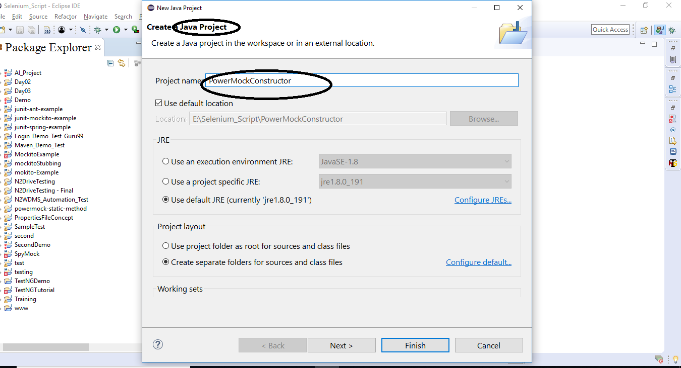
PowerMock and Mockito to mock a constructor Duration: 10 min
Example:
1.Creating a project

Slide 88
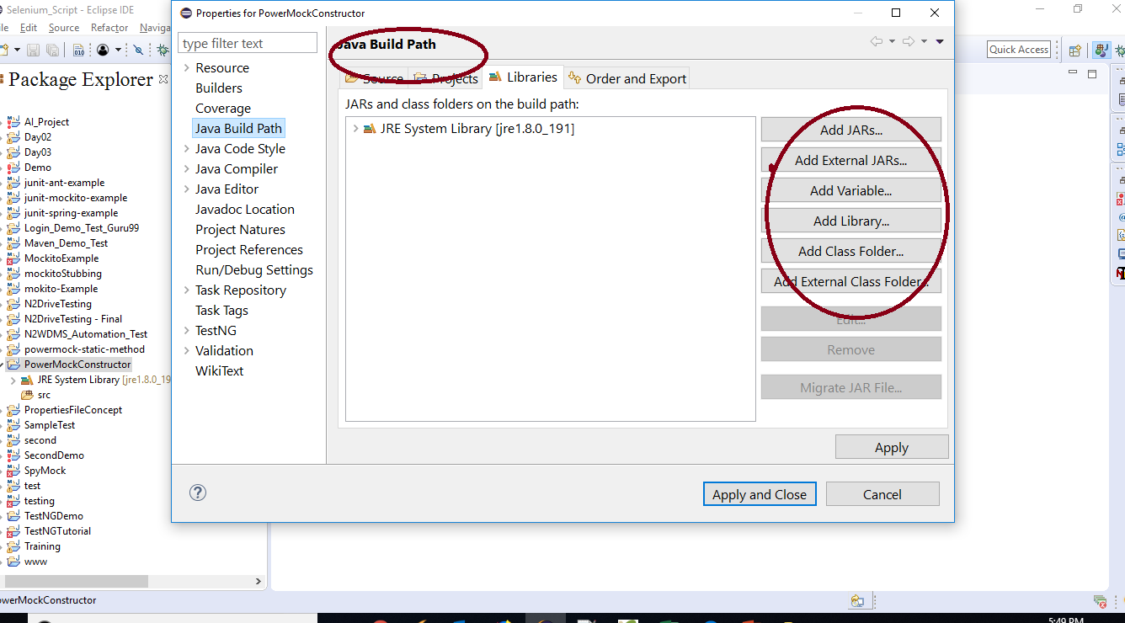
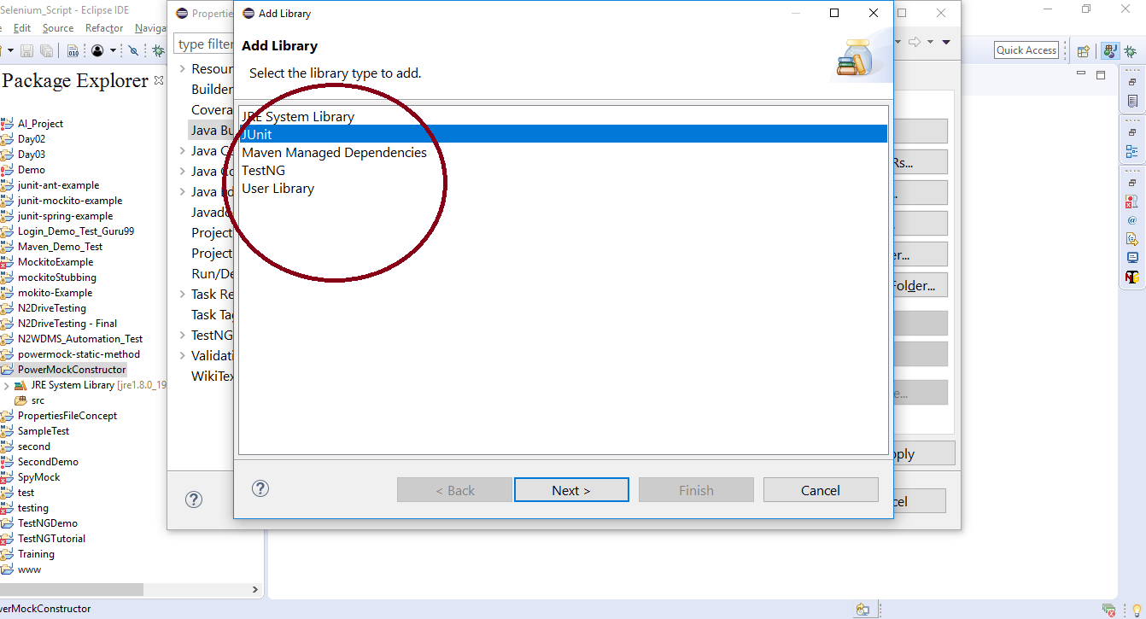
PowerMock and Mockito to mock a constructor Cont..
Dependencies
2.Add jar files and Libraries

Slide 89
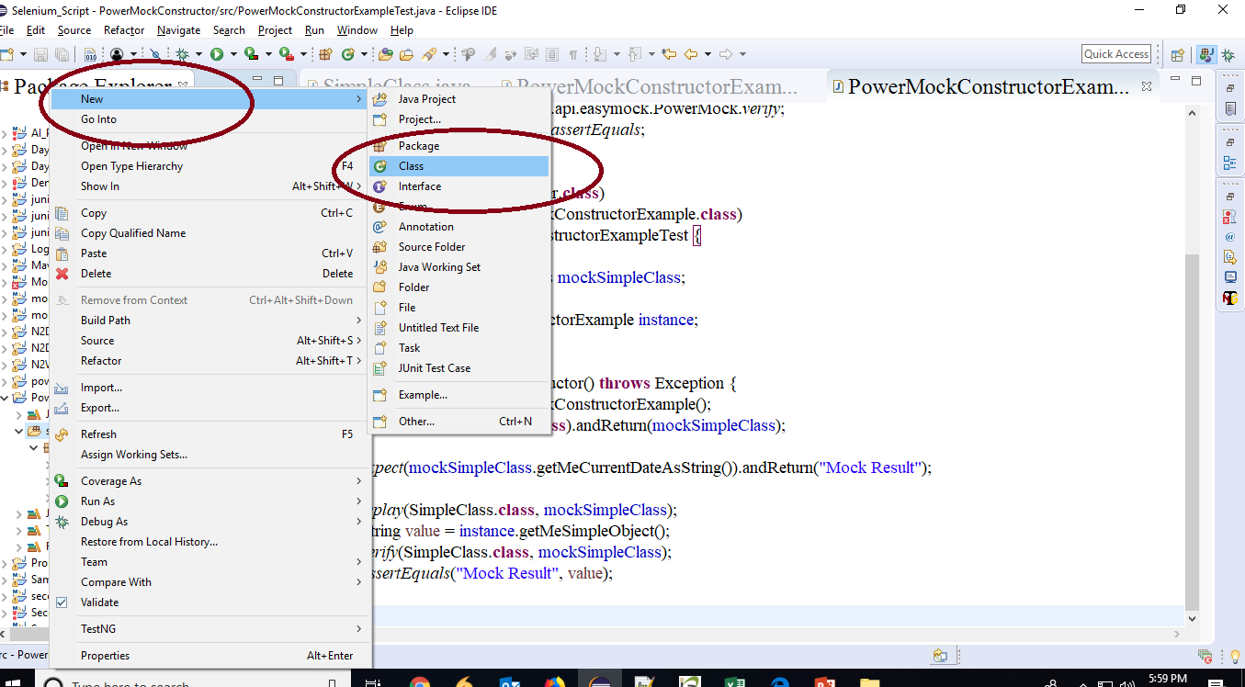

PowerMock and Mockito to mock a constructor Cont..
Code
3. We have a class here with only 1 method

Slide 90

PowerMock and Mockito to mock a constructor Cont..
Code
4. We need to initialize SimpleClass for this we will create a separate class and will call getMeCurrentDateAsString() method of this class.

Slide 91

PowerMock and Mockito to mock a constructor Cont..
Code
5. the test class.

Slide 92
Good Unit Tests.
Unit testing principles demand that a good test is:
Easy to write
Readable
Reliable
Fast
Truly unit, not integration

Slide 93
Summary
In this Module, we have learnt the following:
What is JUnit
How to define a test in Junit
Download Junit and Their Jar Files
Environment Setup
Annotations for Junit testing
Assert class in JUnit
Mockito framework
Setup an Eclipse with Junit and Mockito Framework
Use Of Stub
Mockito Configuration And Example
Mockito Vs EasyMock
BDD And Given When Then
Capture An Argument
Hamcrest Matchers
Junit Rules
Use Of Spy
PowerMock And Mockito

Slide 94

Thank You

